Slide 1

Investor Presentation
December 10th 2023

Slide 2
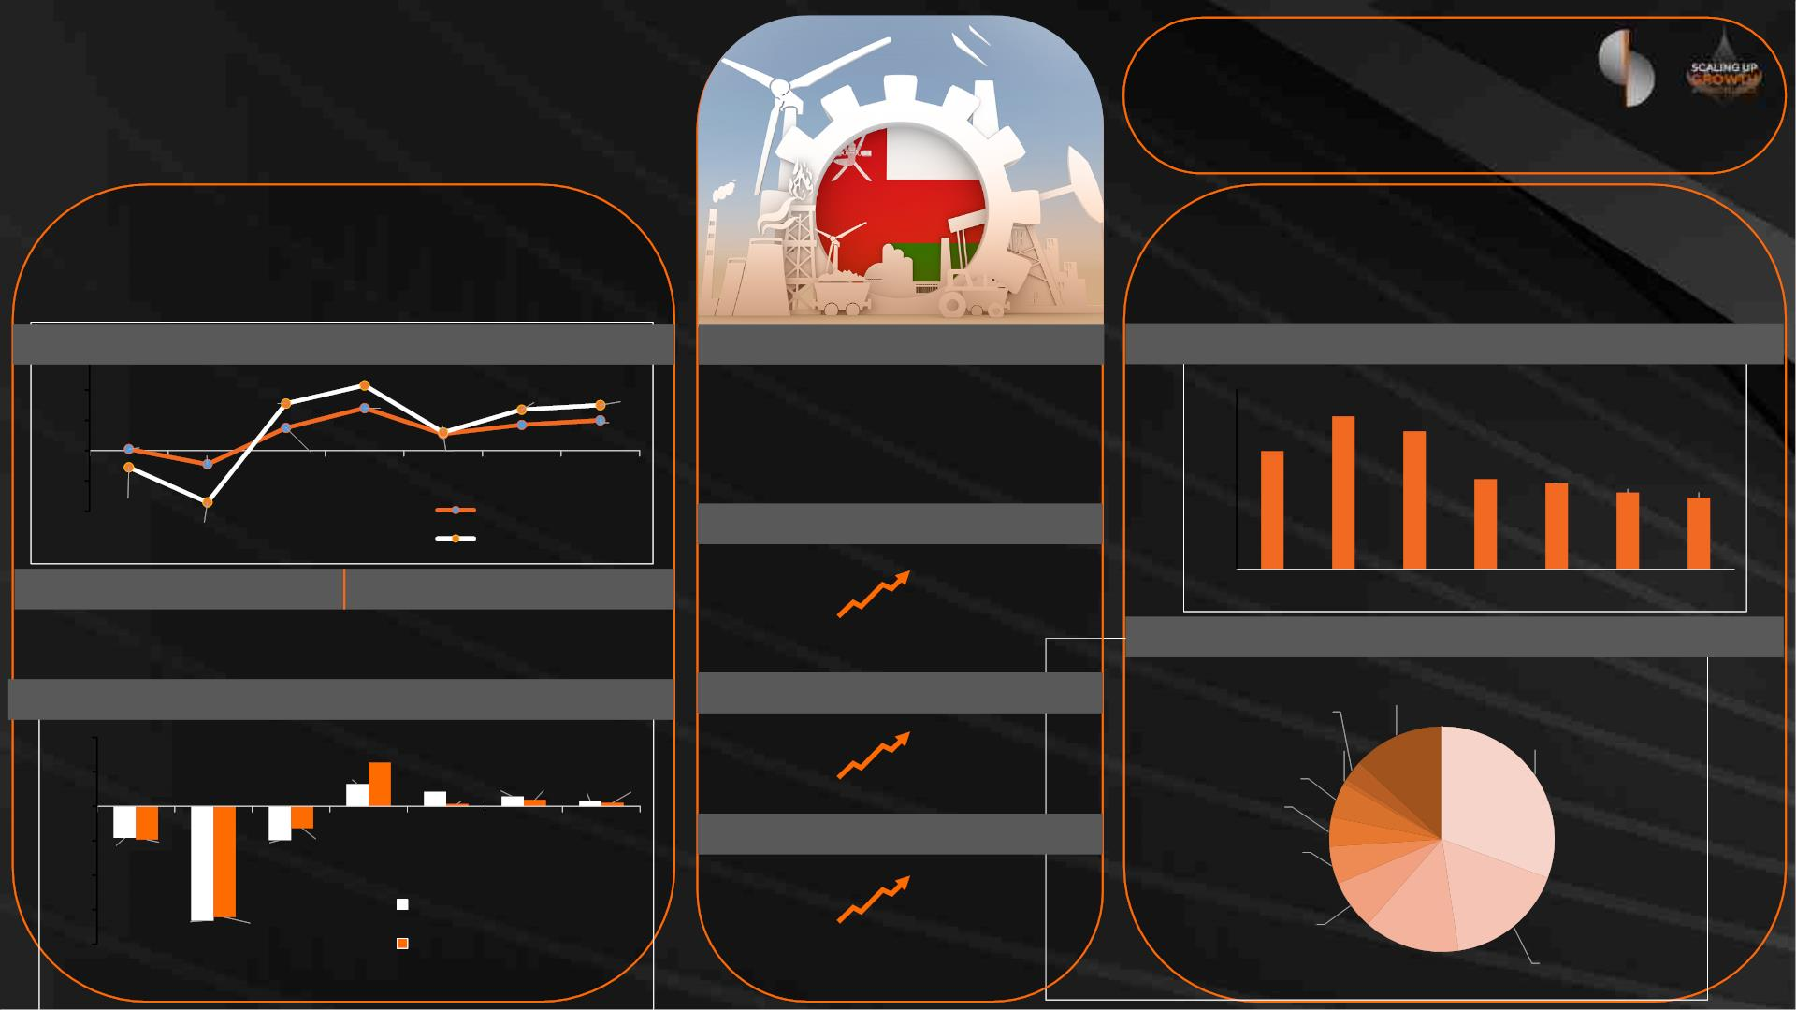
Oman Economic
Overview
Moody’s
Ba1
(Stable)
Fitch
BB+
(Stable)
S&P
BB+
(Stable)
GDP (Current Prices)
GDP Growth
Inflation
Debt
RO17.7 B
Debt/GDP
40%
RO 44.1 B
4.3% 2.8%
Real GDP Growth vs. Inflation Rate
Inflation
Govt. Debt as a % of GDP
6%
4%
4.3%
3.1%
1.5%
2.7%
3.0%
2nd GCC
11th Globally
80%
70%
60%
50%
40%
30%
20%
10%
0%
67.9%
2%
2.8%
1.2%
1.1%
2.0%
52.5%
61.3%
0%
0.1%
-0.9%
2020
1.7%
2019
2021
2022
2023E
2024F
2025F
40.0%
38.2%
34.0%
2024F
-2%
-4%
31.9%
2025F
-1.1%
Inflation
GDP/capita (current US$) (2022)
-3.4%
Real GDP Growth
Overall Balance
Current Account
$12,647
Global
average
$25,056
2019
2020
2021
2022
2023E
6.3%
3.2%
Oman
GDP Composition by Sector
FDI Net Inflow (% to GDP) (2021)
Agriculture &
Fishing, 3%
Hotels & restaurants,
1%
Other Services ,
13%
Current Account Balance vs. Overall Balance
2.1%
4.6%
Petroleum
Activities, 31%
10%
5%
6.3%
3.2%
Real estate
services, 5%
2.1%
0.3%
1.4% 0.9% 0.8% 0.5%
World
Oman
0%
Financial
intermediation,
4%
-5%
2019
2020
2021
-3.2%
-4.9%
2022
2023E
2024F
2025F
Budget Surplus
-4.6%
-4.8%
Transport,
storage,
-10%
-15%
-20%
$1.16 B
communication,
5%
Current Account Balance
Net lending/borrowing
$924 M
-16.6% -16.1%
Q1 2022
Q1 2023
Wholesale &
Retail Trade, 7%
Industry
Activities, 17%
(Includes: C
Public admin &
defence, 14%

Slide 3
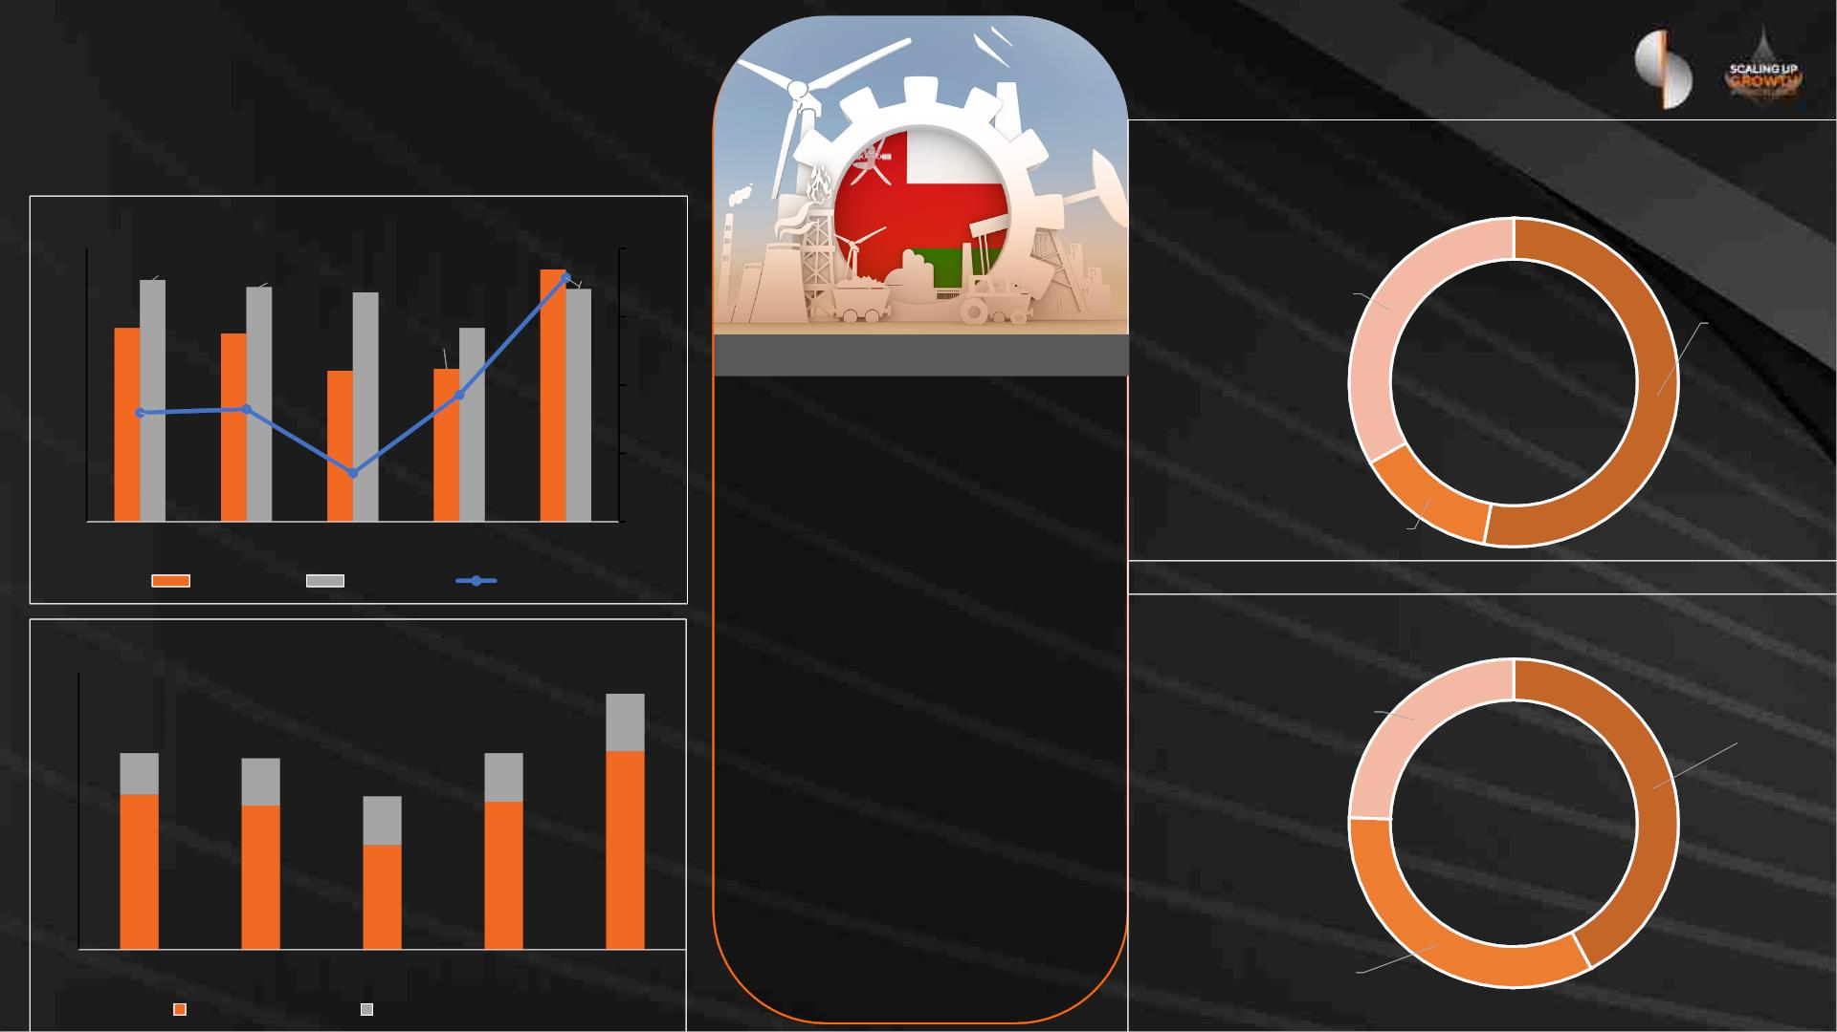
Oman Economic
Overview
2023 Revenues Breakup
Financial Performance Trend (USD B)
36.9
40.0
35.0
30.0
25.0
20.0
15.0
10.0
5.0
35.4
28.3
34.3
27.6
34.1
5.0
33.5
Non-
hydrocarbon,
OMR 3330 M,
28.3
22.4
2.9
0.0
Oil Revenue,
OMR 5320 M,
22.1
2023 Budgets
(5.7)
-5.0
-10.0
-15.0
(6.8)
Projected Revenue
(7.0)
(11.4)
OMR 10.1 B
0.0
Projected Expenditure
Gas Revenue,
OMR 1400 M,
2018
2019
Revenue
2020
Expense
2021
2022
Deficit
OMR 11.4 B
2023 Investment Spending
Projected Deficit
40
35
30
25
20
15
10
5
Revenue Breakup (USD B)
OMR 1.3 B
36.9
8.3
Development budget, Projects
with developmental impact,
OMR 1.1 B
Oman Investment
Authority, OMR 1.9 B
28.3
6.0
27.6
6.8
28.3
7.0
Projected average oil price
22.1
7.0
$55
Allocations
OMR 4.5 B
28.6
Projected average oil
production
22.4
20.8
21.3
15.1
1,175
(thousand barrels per day)
0
Energy
Development
Oman, OMR 1.5 B
2018
2019
2020
2021
2022
Hydrocarbon
Non-hydrocarbon

Slide 4
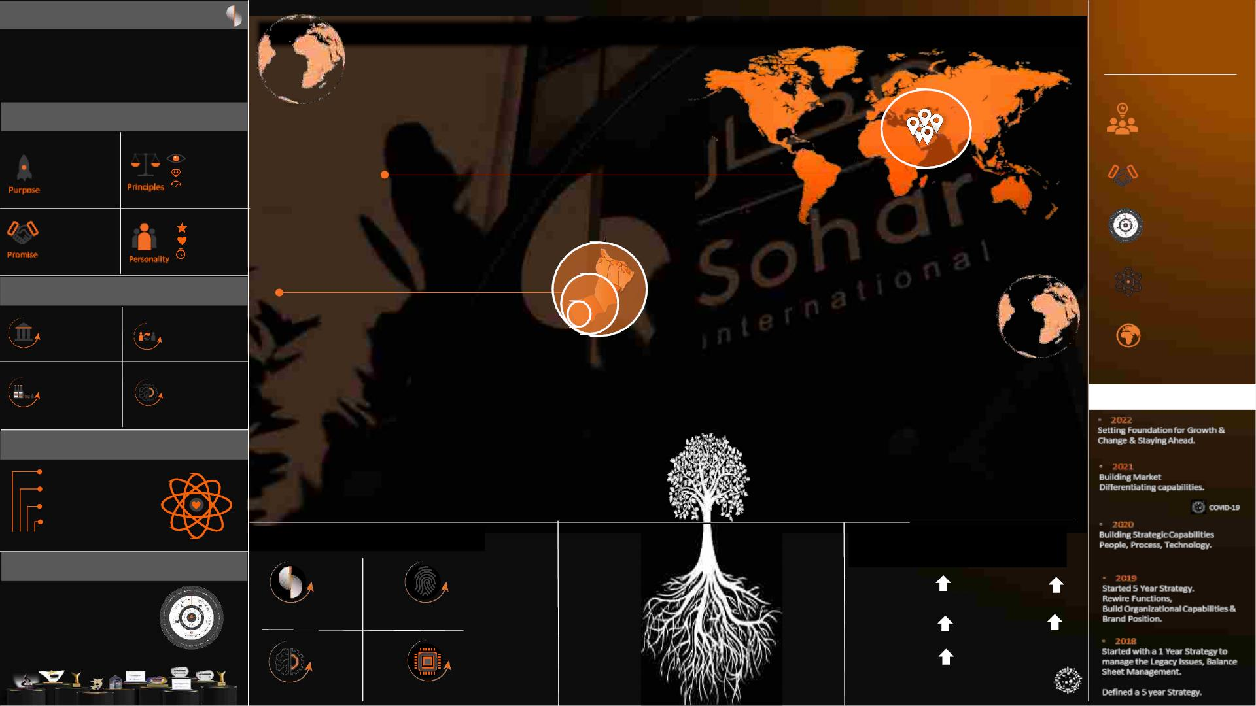
Vision
THE VISION GUIDES OUR EFFORTS TO BUILD THE BANK OF THE
FUTURE
Relevance &
Resilience
To be a World Leading
Omani Service Company that helps
customers, communities and people to
prosper and grow
Pillars of Vision
Commit to A Customer
Orientated Approach.
Internationalize Our Business
a) Kingdom of Saudi Arabia (2023)
We Help People
‘WIN’.
More Vision
More Value
More Velocity
KSA
Commit to
Excellence.
Responsive
Services to reach
your Goal.
Sharp
Human
Unstoppable
Oman
Put Competitive
Advantage First.
Solidify Our Domestic Presence
a) Organic.
b) In-Organic Growth - M&A.
Pillars of Strategy
Fastest
Growing
Bank in Oman
Make the Trend
our Friend.
Re-Imagine
Banking
Business
Re-Evaluate
Value
Chains
Stay Ahead &
Turbo Charge our Core.
Re-connect
with Our
Customers
Re-build
the
Organization
5 Year Strategy
Share Holders
Values
S T R I V I N G T O
H E L P Y O U
W I N
Customers
Employees
Be Open Minded.
Do the Right Thing.
Be Straight Up.
Society
Regulators
Make it Better.
1 2 3 4
Build Strong Deep Rooted Foundation
Built Strong Financial Position
(GROWTH Sept. 2018 – Sept. 2023)
The Winning Formula
5
115 %
Assets
86 %
Net Loans
5
Creating an
Ecosystem of
Services
Brand
People
169 %
Deposits
5
332 % ⁵
CASA
5
92%
Operating Profit
Weathered
impacts of
COVID
Process
Technology
(before impairment)

Slide 5
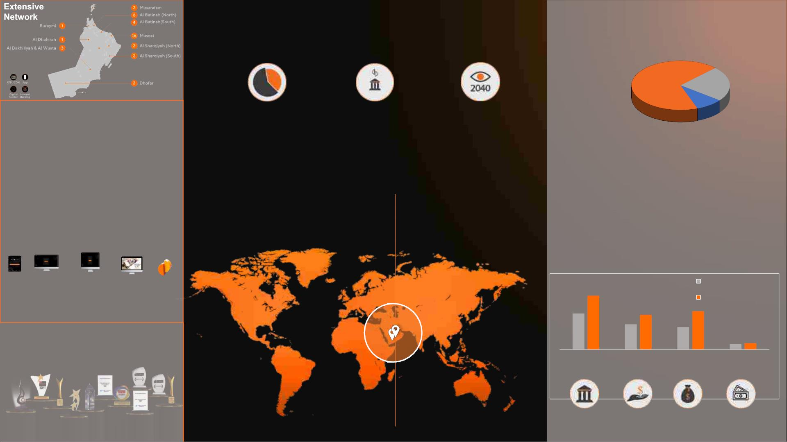
Sohar International
Ownership
Government & Quasi Govt.
68%
Institutions
23%
Extensive Digital
Channels
Fastest Growing 2nd Largest Bank
Bank in Oman in Oman
Oman’s
Vision 2040
Other
9 %
• Mobile Banking
• Online Banking
• Corporate Internet Banking
• Transaction Banking
• Business to Business
Listed on the Muscat Stock Exchange (MSX)
Market Capitalization: ~ USD 1.5 Billion
Pre-merger
(YTD Jun 2023)
Post-
merger
Growth
50%
Market Share
(Total Assets)
12% 18%
Strong domestic market presence
a) Organic
b) In-Organic Growth - M&A
No of branches
No of Staff
39
85
118%
79%
884 1,582
Mobile
Banking
Retail
Internet Banking
Corporate
Internet Banking
Transaction
Banking
H2H
Pre-merger (YTD Jun
2023)
Post-merger
Total Assets Net Loans Customer Total Capital
Deposits
Internationalization of Our Business
> Kingdom of Saudi Arabia (2023)
50%
38%
71%
16%

Slide 6
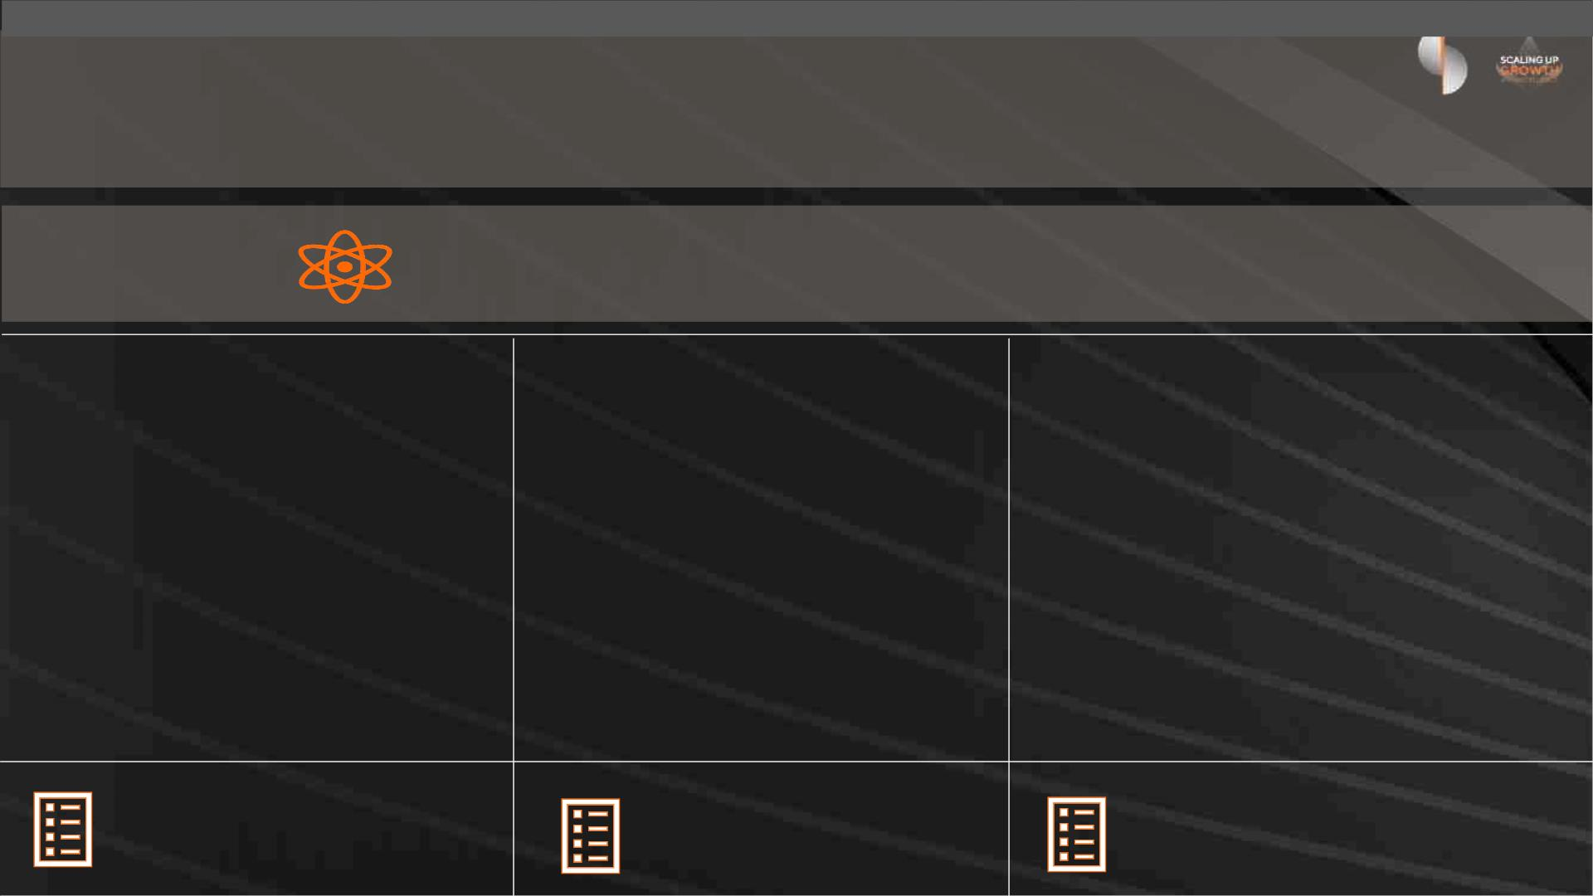
ESG Commitment to enable a positive social, environmental and economic
impact and change, supporting our stakeholders to prosper and grow
Striving to Achieve Excellence In Sustainability
1. Strategic ESG Focus
2. Sustainable Financing
Activities
3. Thought Leadership &
Engagement
• Exclusive Bank sponsor for the Green Hydrogen
Summit Oman 2023
• Arab Federation of Capital Markets
• Future Sustainability Futures Forum Dubai
• Solar Week Oman 2023
• 3rd Sustainability Conference Oman
• One of two banks in attendance at Estidamah’s
Sustainable Finance Workshop
• Conducted ESG benchmarking and
materiality assessment
• Developed final ESG framework
• ESG framework approved by Sohar
International Board 29 October 2023
• Official launch of ESG framework
scheduled for Q1 2024
• Signed mandate with World Bank IFC
for USD200 million of climate-related
financing
• Pipeline of over RO 450 million
sustainable finance opportunities
identified to-date
• MSX ESG Metrics ESG Data Platform Workshop
Powered by ESG Framework
Powered by ESG Framework
Powered by ESG Framework

Slide 7
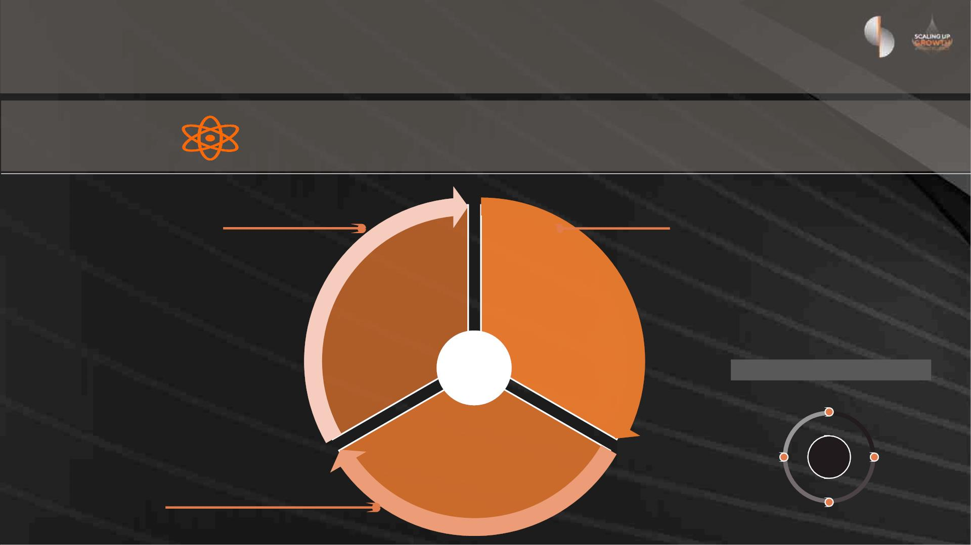
Our ESG Framework
Striving to Achieve Excellence In Sustainability
• Sustainable Finance and Investment
(Decarbonisation; NetZero; Biodiversity and
Natural Capital)
• Governance, Compliance and Ethics (Culture) (AML
and Anti-corruption; Transparency; Financial
performance)
E&S Product / Service Innovation)
• Sustainable Supply Chain / Procurement
• Direct environmental footprint (Energy;
Waste; and Water management)
Enabling the
transition to a
sustainable
future
Embedding
responsible
business
• E and S risk management (ESRM) (including climate
risk)
• Digital Leadership
operations
• Human Capital (Employee Health Safety and
Wellbeing; Diversity and Inclusion; Talent
Attraction; Engagement & Retention;
Strategy
Underpinned by our values
Employee Training and Development)
Be Straight Up
• Customer protection (Privacy and security;
Responsible Communications & Marketing)
• Customer experience
Empowering and
developing people –
employees, customers
and communities
Be Open
Minded
Values
Make it
better
• Financial inclusion, accessibility and
education (financial empowerment)
• Community investment and socio-economic
development [CSR]
Do the Right Thing

Slide 8

Financial
Review

Slide 9
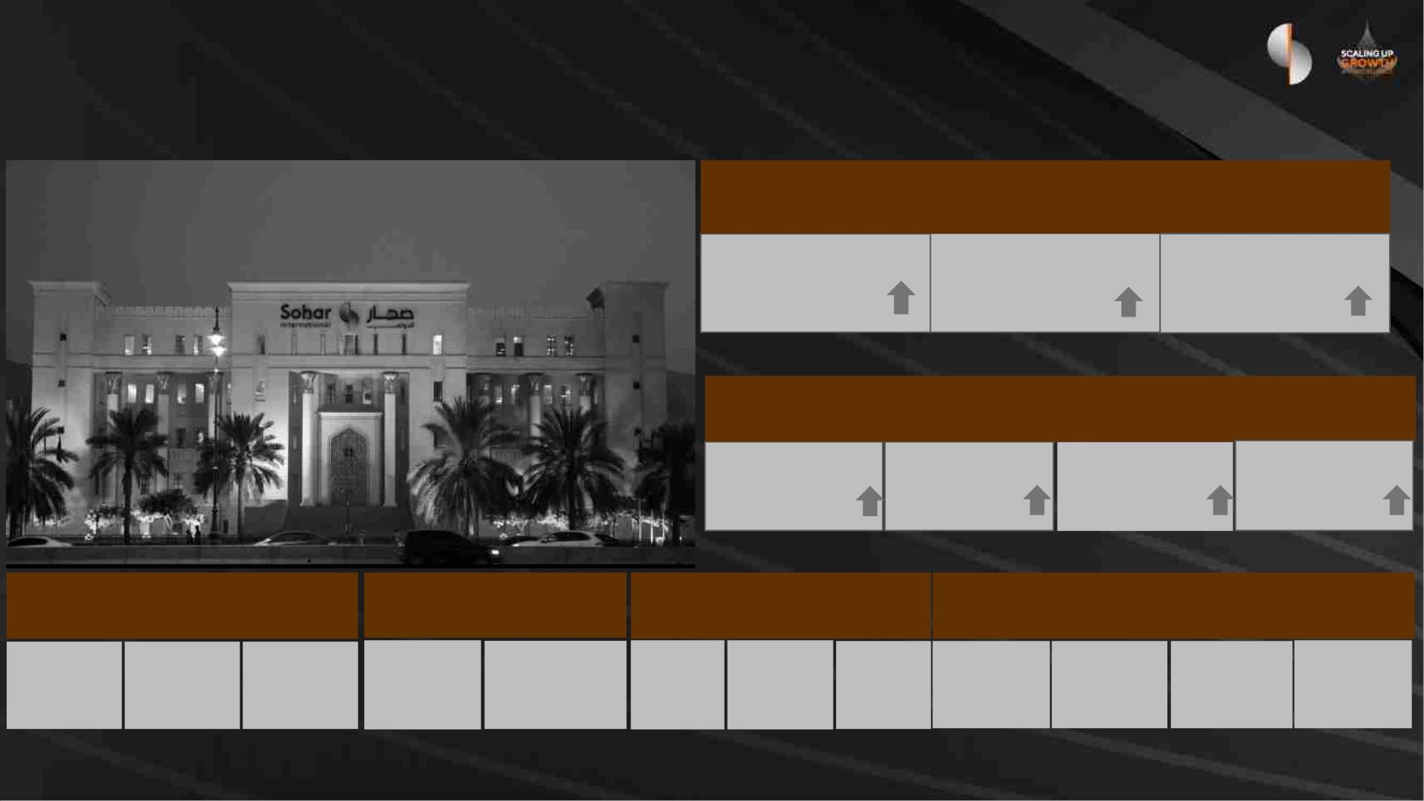
Our Results (September 2023 )
Earnings (RO M)
Operating Income
125.9 (+30%)
Net Profit
45.7
(+63%)
Operating Profit
76.5 (+34%)
Balance Sheet (RO M)
Total Assets
6,369 (50%)
Total Equity
689 (23%)
Net Loans
4,131
(48%)
Total Deposits
4,626
(76%)
Earnings & Profitability Credit Quality
Capitalization
Funding & Liquidity
(1)
ROE
9.7%
ROA
1.2%
CIR
39.3%
NPL Ratio NPL Coverage
CET 1
Tier 1
CAR
LCR
138%
NSFR
129%
CASA %
66%
LTD %
89%
4.9%
102%
13.5% 15.6% 16.2%
Note 1 : Capital Ratios for interim reporting periods exclude interim profits

Slide 10
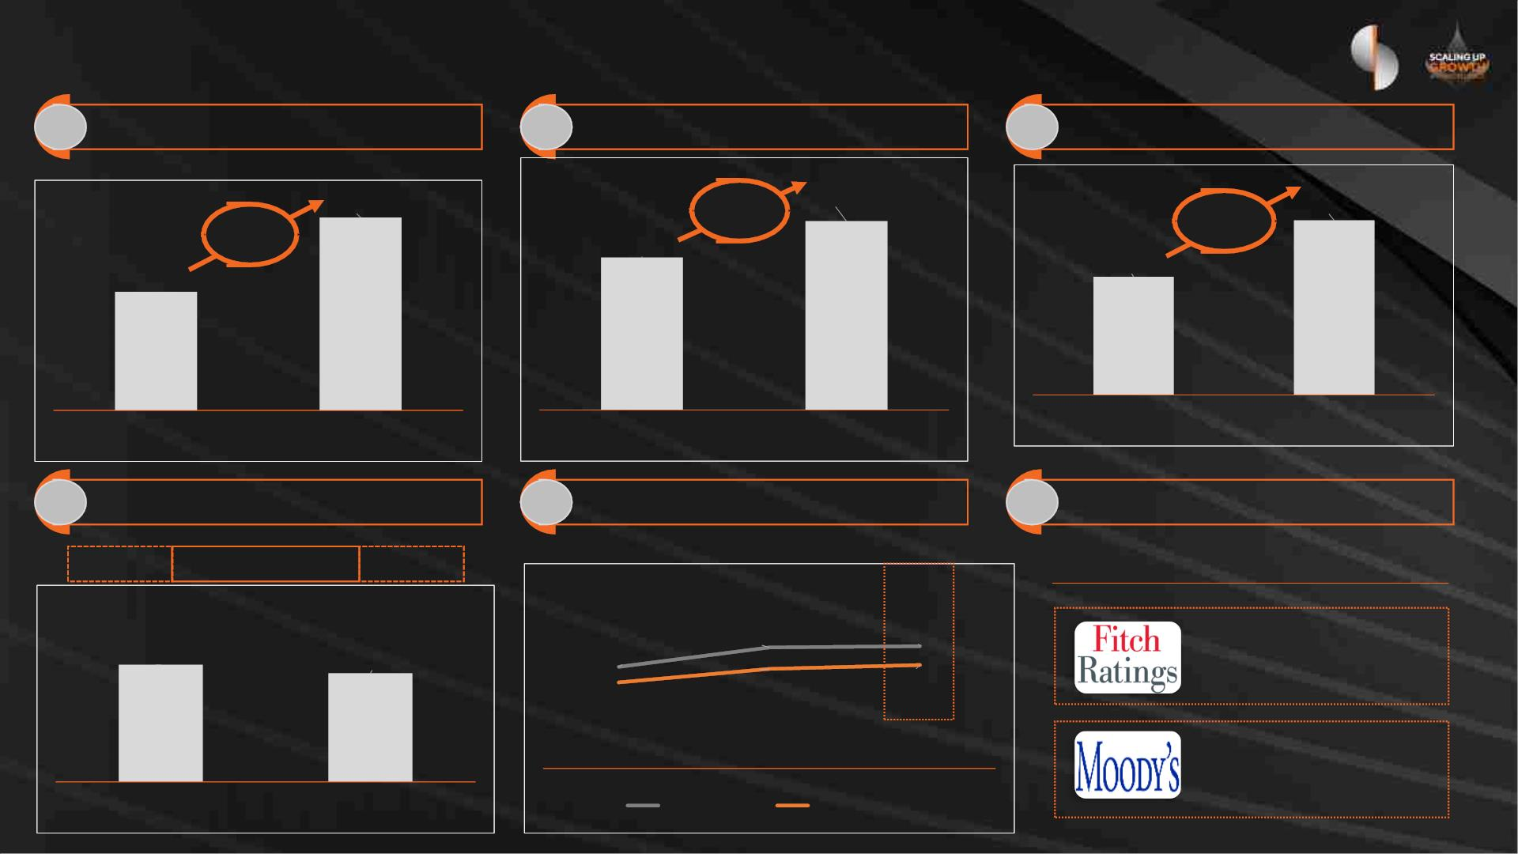
Our Results: Key Highlights (September 2023)
1 Profit for the period
2 Return on Equity
3 Net Loans and Advances
RO million
45.7
9.7%
RO
million
4,131
1.9%
48%
63%
7.8%
2,797
28.1
9 months 2022
9 months 2023
9 months 2022
9 months 2023
30-Sep-22
30-Sep-23
4 Asset Quality
5 Capital Ratios
6 Credit Ratings
80%
NPL Ratio %
5.3%
Coverage Ratio
102%
Credit Rating Outlook
CET1
Tier 1
CAR
18.9%
15.6%
19.1%
16.2%
4.9%
15.9%
13.5%
BB
Stable
Ba2
Positive
30-Sep-22
30-Sep-23
30-Sep-22
30-Sep-23

Slide 11
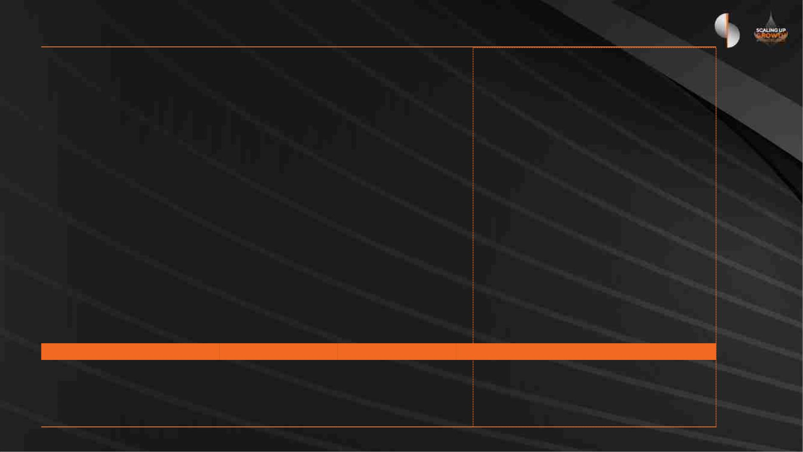
Profit for the 9 month period ended 30 September
RO Million
9 months
2023
9 months
2022
Variance Sept 2023 v Sept 2022
Amount
46.2
%
Interest income
166.9
(88.3)
78.6
120.7
(51.5)
69.2
38 %
Interest expense
Net interest income
(36.8)
9.4
(71) %
13.6 %
Net income from Islamic financing
and investing activities
5.7
6.8
(1.1)
(16) %
Other operating income
Gain on bargain purchase
Totaloperating income
25.0
16.6
20.6
0.0
4.4
21 %
16.6
29.3
(9.7)
n/a
125.9
(49.4)
96.6
(39.7)
30.3 %
Total operating expenses
Net operating income before
impairment provisions
(24) %
76.5
56.9
19.6
34.4 %
Loan impairment charges and other
credit risk provisions (net)
(22.8)
(23.9)
1.1
4.6 %
Profit before tax
53.7
(8.0)
45.7
33.0
(4.9)
28.1
20.7
(3.1)
17.6
62.7 %
(63) %
62.7 %
0.3 %
1.9 %
1.8 %
0.4 %
Tax expense
Profit for the period
Return on assets (ROA) %
Return on equity (ROE) %
Cost to income ratio (CIR) %
Cost of risk
1.2%
9.7%
39.3%
0.7%
0.9%
7.8%
41.1%
1.1%

Slide 12
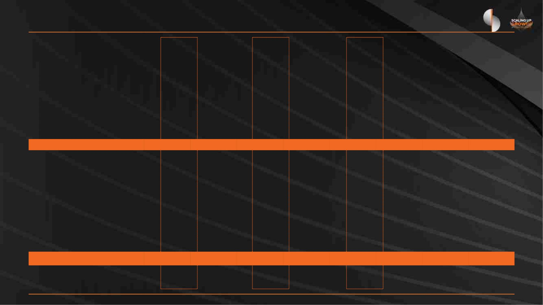
Balance Sheet as at 30 September
Variance
RO Million
30-Sep-23
% of Total
31-Dec-22
% of Total
30-Sep-22
% of Total
Sep 23 vs Sep 22
Amount
%
ASSETS
Cash and balances with Central Bank
Due from banks
249.5
361.3
3.9%
5.7%
125.9
104.0
3.0%
2.5%
83.7
281.1
2.0%
6.6%
165.8
80.2
198 %
29 %
66 %
48 %
Investment securities
1,448.1
4,131.2
22.7%
65.0%
853.8
20.7%
70.8%
874.9
20.6%
65.8%
573.2
Loans, advances and Islamic financings (net)
2,924.3
2,796.6
1,334.6
Other assets
103.2
2.9
1.6%
0.0%
66.7
2.9
1.6%
0.1%
154.5
2.9
3.6%
0.1%
(51.3)
-
(33) %
0 %
Investment properties
Property and equipment
73.0
1.1%
53.4
1.3%
54.5
1.3%
18.5
34 %
TOTAL ASSETS
LIABILITIES
6,369.2
100.0%
4,131.0
100.0%
4,248.2
100.0%
2,121.0
49.9 %
Due to banks
Customer deposits
782.1
12.3%
72.6%
806.0
19.5%
62.0%
738.9
17.4%
61.8%
43.2
6 %
4,625.9
2,560.1
2,626.0
1,999.9
76 %
Other liabilities
Subordinated loans
Total liabilities
171.9
-
2.7%
0.0%
98.9
0.5
2.4%
0.0%
189.3
35.6
4.5%
0.8%
(17.4)
(35.6)
(9) %
(100) %
55.4 %
5,579.9
87.6%
3,465.5
83.9%
3,589.8
84.5%
1,990.1
Total shareholders’ equity
Perpetual tier 1 capital securities
Total equity
689.3
100.0
789.3
10.8%
1.6%
565.5
100.0
665.5
13.7%
2.4%
558.4
100.0
658.4
13.1%
2.4%
130.9
-
23 %
0 %
12.4%
16.1%
15.5%
130.9
19.9 %
TOTAL LIABILITIES AND EQUITY
6,369.2
100.0%
4,131.0
100.0%
4,248.2
100.0%
2,121.0
49.9%
Net loans / deposits
CASA ratio
89.3%
65.5%
114.2%
63.8%
106.5%
65.2%

Slide 13
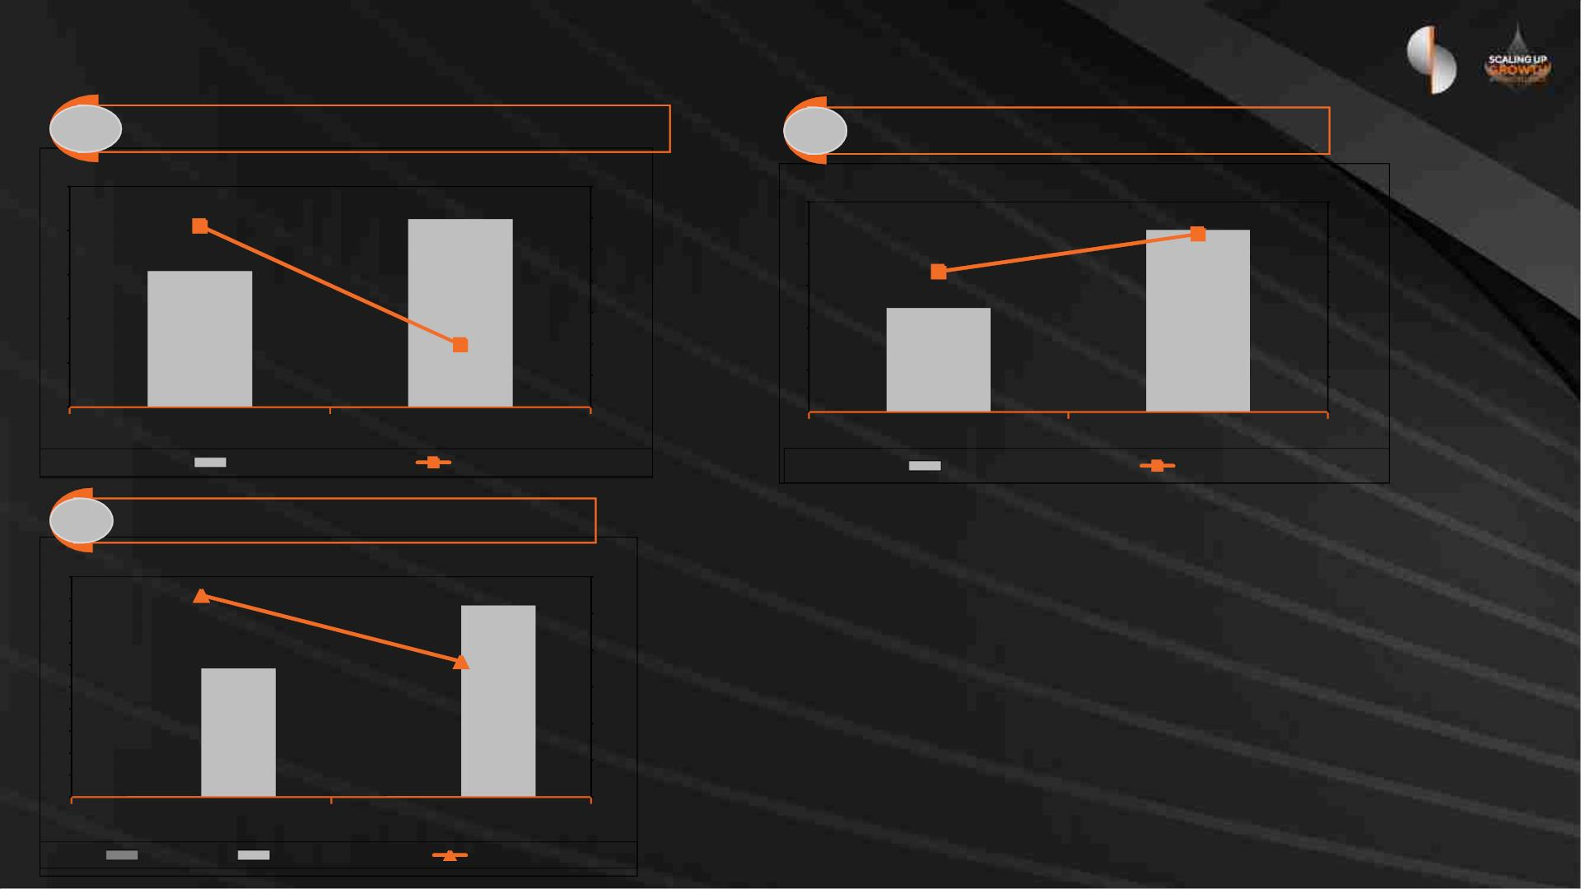
Credit Quality
1 Non Performing Loans (NPL)
2
NPL Coverage
250
200
150
100
50
RO million
5.3%
5.4%
5.3%
5.2%
5.1%
5.0%
4.9%
4.8%
4.7%
RO million
250
200
150
100
50
102%
216
120%
100%
80%
60%
40%
20%
0%
213
80%
124
154
4.9%
0
0
30-Sep-22
30-Sep-23
30-Sep-22
30-Sep-23
NPL
NPL %
Provision
Coverage %
3 Cost of Risk
RO million
1.1%
5,000
4,500
4,000
3,500
3,000
2,500
2,000
1,500
1,000
500
1%
1%
1%
1%
0%
0%
0%
4,347
0.7%
2,921
24
23
30-Sep-23
0
30-Sep-22
ECL
Gross Loans
Cost of Risk %

Slide 14
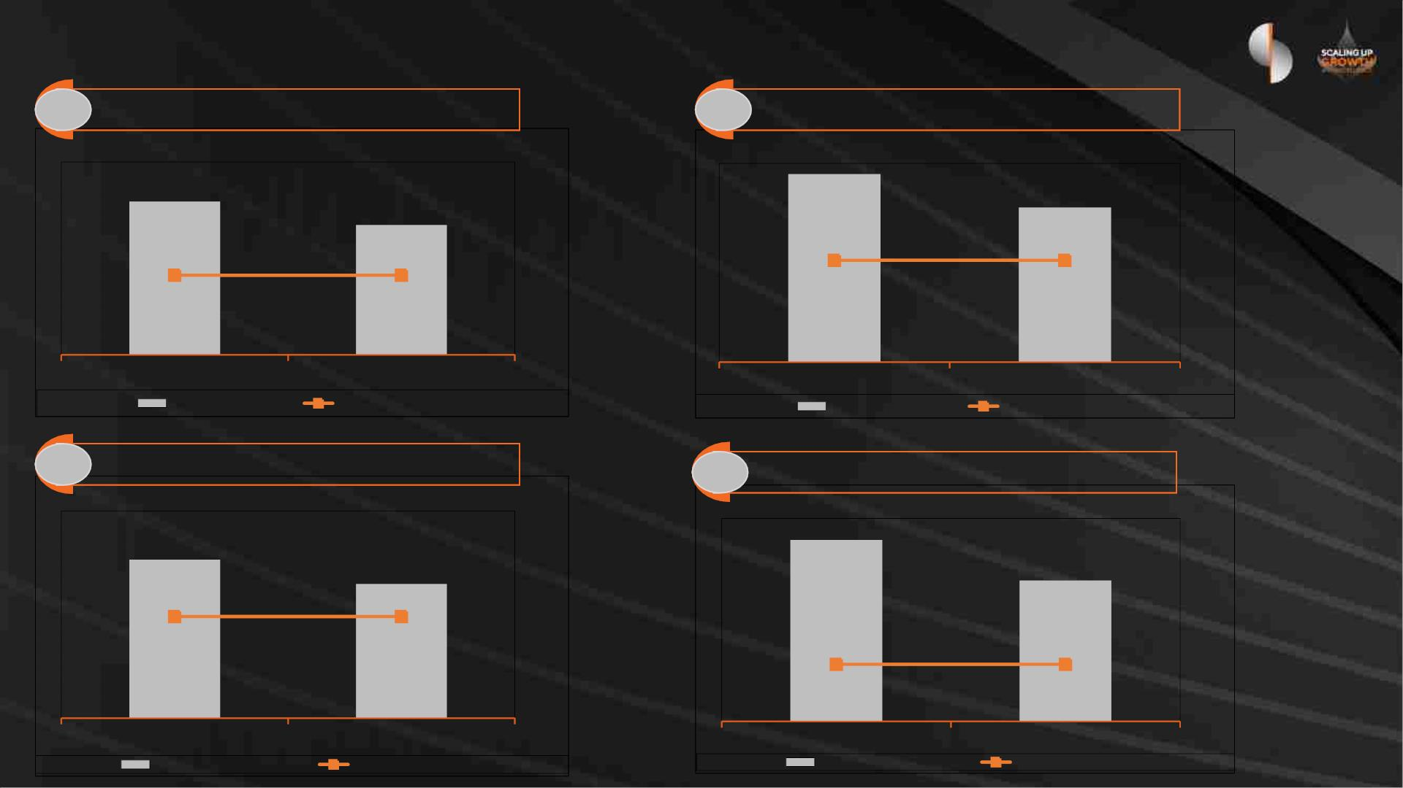
Capital & Leverage
1 CET 1 Ratio
2 Tier 1 Ratio
18.9%
15.9%
15.6%
13.5%
8.25%
8.25%
10.25%
10.25%
30-Sep-22
CET1
30-Sep-23
Minimum Regulatory
30-Sep-22
Tier 1
30-Sep-23
Minimum Regulatory
3 Total Capital Ratio
4 Leverage Ratio ( Local Regulatory basis)
14.3%
19.1%
16.2%
11.1%
12.25%
12.25%
4.50%
4.50%
30-Sep-22
Total Capital
30-Sep-23
Minimum Regulatory
30-Sep-22
Leverage %
30-Sep-23
Minimum Regulatory

Slide 15
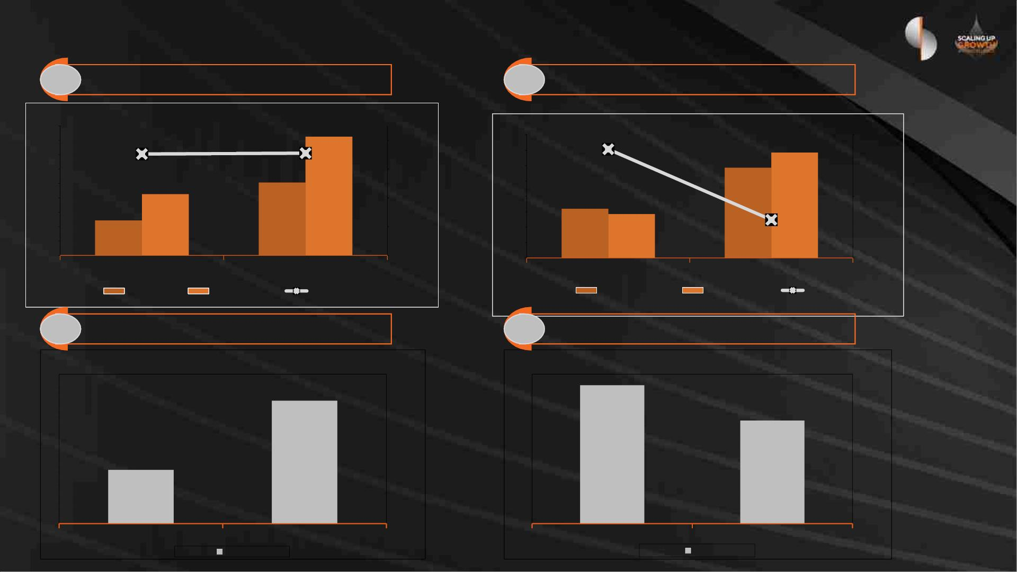
Funding & Liquidity
1 CASA / Customer Deposits %
2 Net Loans to Deposits %
RO billion
RO billion
5.0
4.5
4.0
3.5
3.0
2.5
2.0
1.5
65%
66%
5.2
4.7
4.2
3.7
3.2
2.7
2.2
1.7
106%
4.6
110.0%
95.0%
80.0%
70.0%
60.0%
50.0%
40.0%
30.0%
4.1
4.6
2.8
2.6
89%
2.6
3.0
1.0
1.7
0.5
1.2
30-Sep-22
30-Sep-23
30-Sep-22
30-Sep-23
CASA
Deposits
CASA %
Net Loans
Deposits
LTD
3 Net Stable Funding Ratio (NSFR)
4 Liquidity Coverage Ratio (LCR)
185%
129%
138%
113%
30-Sep-22
NSFR
30-Sep-23
30-Sep-22
LCR
30-Sep-23

Slide 16

Disclaimer
Important notice
The information, statements and opinions set out in this presentation and accompanying discussion (“this Presentation”) are for informational and reference purposes only and do not
constitute a public offer for the purposes of any applicable law or an offer to sell or solicitation of any offer to purchase any securities or other financial instruments or any advice or
recommendation.
This Presentation, which does not purport to be comprehensive nor render any form of legal, tax, investment, accounting, financial or other advice, has been provided by Sohar
International (“the Bank”) and has not been independently verified by any person. You should consult your own advisers as to legal, tax investment, accounting, financial or other related
matters concerning any investment in any securities. No responsibility, liability or obligation (whether in tort, contract or otherwise) is accepted by the Bank or their officers, employees,
agents or advisers as to or in relation to this Presentation (including the accuracy,completeness or sufficiency thereof) or any other written or oral information made available or any errors
contained therein or omissions therefrom, and any such liability is expressly disclaimed.
Forward looking information
The financial information and other numerical disclosures in this presentation are unaudited. The most recent Annual Report, audited annual financial statements and unaudited quarterly
interim condensed financial statements are available on the Bank’s website.
This Presentation may contain forward-looking statements. Forward-looking statements are statements that are not historical facts; they include statements about our beliefs and
expectations and the assumptions underlying them.
These statements are based on plans, estimates and projections as they are currently available to the management of the Bank. Forward-looking statements therefore speak only as of the
date they are made, and we undertake no obligation to update publicly any of them in light of new information or future events. By their very nature, forward-looking statements involve
risks and uncertainties. A number of important factors could therefore cause actual results to differ materially from those contained in any forward-looking statement. Such factors include
the conditions in the financial markets in the Sultanate, the prevailing market volatility, potential defaults of borrowers or trading counterparties, the implementation of our strategic
initiatives, the reliability of our risk management policies, procedures and other risks.
Non-IFRS measures
This presentation also contains non-IFRS financial detail.

Slide 17

Q & A

