Slide 1

Investor Presentation
April 3rd 2024

Slide 2
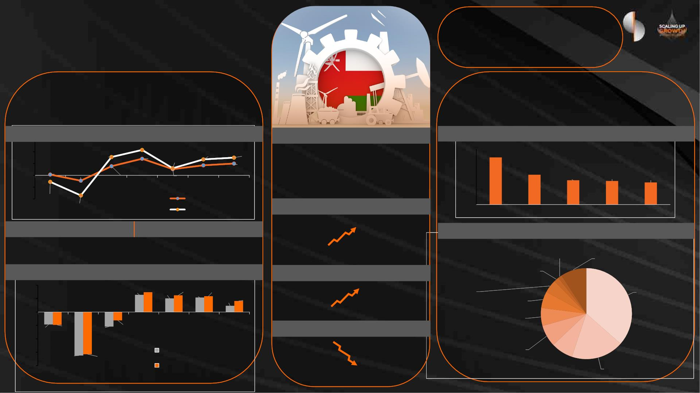
Oman Economic
Overview
Moody’s
Ba1
(Stable)
Fitch
BB+
(Stable) (Positive)
S&P
BB+
(Dec’23)
(Sep’23)
(Mar’24)
Debt
RO15.2 bn
Debt/GDP
35%
GDP (Current Prices) GDP Growth
Inflation
RO 41.7 bn
1.2% 1.1%
2023, Source: IMF
2023, Source: MoF
Real GDP Growth vs. Inflation Rate
Inflation
Govt. Debt as a % of GDP
6%
4%
4.3%
3.1%
1.5%
2.7%
1.7%
3.0%
2.0%
2nd GCC
9th Globally
80%
60%
40%
20%
0%
68.0%
2%
2.8%
1.2%
1.1%
2023
0.1%
-0.9%
2020
43.0%
2022
35.0%
2023
34.0%
0%
31.9%
-2%
-4%
2019
2021
2022
2024F
2025F
-1.1%
Inflation
Oct’23, Source: IMF
-3.4%
Real GDP Growth
GDP / Capita (current US$)
Source: IMF
2021
2024F
2025F
Sources: MoF and statista
Overall Balance
Current Account
$13,330
World
Average
$21,270
GDP Composition by Sector*
6.2%
5.1%
Oman
Hotels and
Agriculture & Restaurants, 1%
Forestry &
Fishing, 2%
Real Estate,
2023, Source: IMF
2023, Source: IMF
Professional &
Technical &
Administrative
Service Activities,
5%
Other Services,
9%
Current Account Balance vs. Overall Balance
FDI Net Inflow (% to GDP)
10%
5%
7.4%
6.2%
5.9%
3.2%
Petroleum
Activities, 36%
6.4%
5.1%
5.4%
4.1%
1.7%
2.3%
World
Average
Oman
Financial Intermediation, 6%
0%
2022, Source: The World Bank
Transportation, Storage,
Telecommunications and
Information Service Activities, 6%
-5%
2019
2020
2021
2022
2023
2024E
2025F
Budget Surplus / (Deficit)
-4.6%
-4.8%
-5.4%
-3.1%
-10%
-15%
-20%
$2.42 bn
Current Account Balance
2023 Preliminary
($1.66 bn)
Wholesale &
Retail Trade, 8%
Non-Petroleum
Industrial Activities, 19%
-16.2% -15.7%
Public
Administration &
Defence, 8%
Net Lending / Borrowing
2024 Projected
Source: IMF
Source: MoF
2022, Source: CBO
* Excluded: Financial Intermediation Services Indirectly Measured & Taxes Less Subsidies on Products

Slide 3
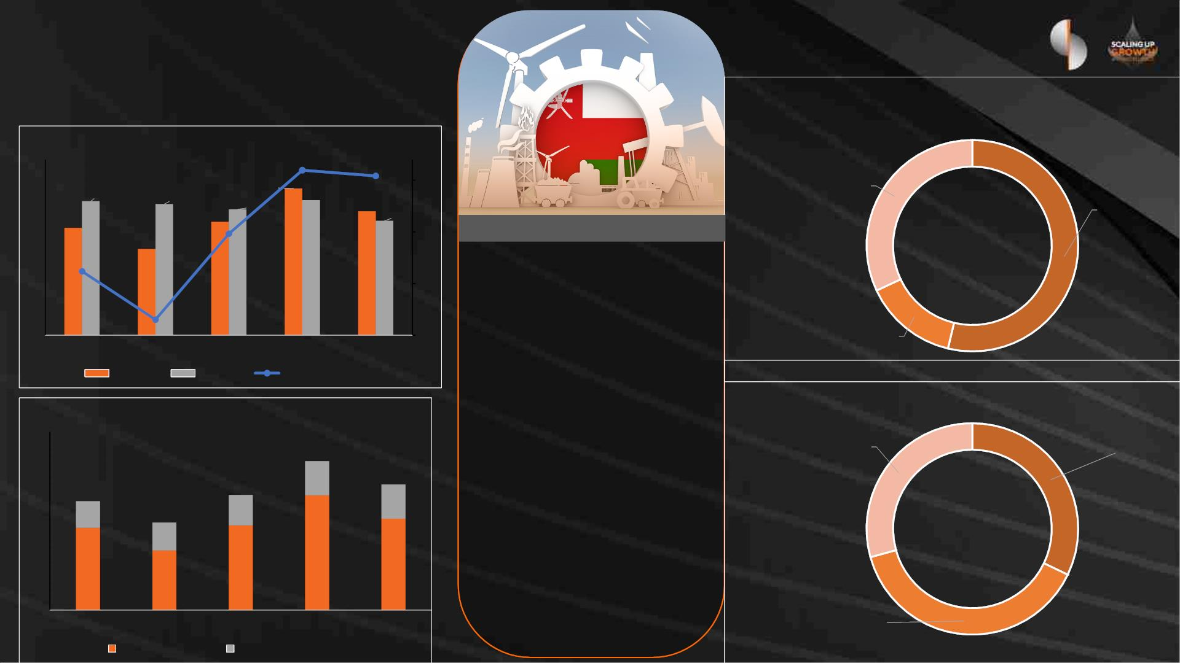
Oman Economic
Overview
2024 Revenues Breakup
Financial Performance Trend (USD bn)
45.0
30.0
15.0
0.0
3.0
Non-
hydrocarbon,
OMR 3520 M,
34.3
27.5
37.6
2.4
2.0
33.6
32.3
34.6
31.7
Oil Revenue,
OMR 5915 M,
29.1
29.3
22.1
-3.2
-3.0
-8.0
-13.0
2024 Budgets
-6.8
Projected Revenue
OMR 11.0 bn
-11.5
Gas Revenue,
OMR 1575 M,
Projected Expenditure
2019
2020
Revenue
2021
Expense
2022
2023
OMR 11.7 bn
Surplus / Deficit
2024 Investment Spending
Projected Deficit
Revenue Breakup (USD bn)
OMR 0.6 bn
Oman Investment
Authority, OMR 1.25 bn
Development budget, Projects
with developmental impact,
OMR 1.14 bn
40
37.6
8.6
31.7
8.6
Projected average oil price
30
20
10
0
27.5
6.7
29.1
7.7
$60
22.1
7.0
Allocations
OMR 3.9 bn
29.0
Projected average oil
production
20.8
21.4
15.1
23.1
1,031
2019
2020
2021
2022
2023
(thousand barrels per day)
Energy Development
Oman, OMR 1.50 bn
Hydrocarbon
Non-hydrocarbon
Source: Ministry of Finance

Slide 4
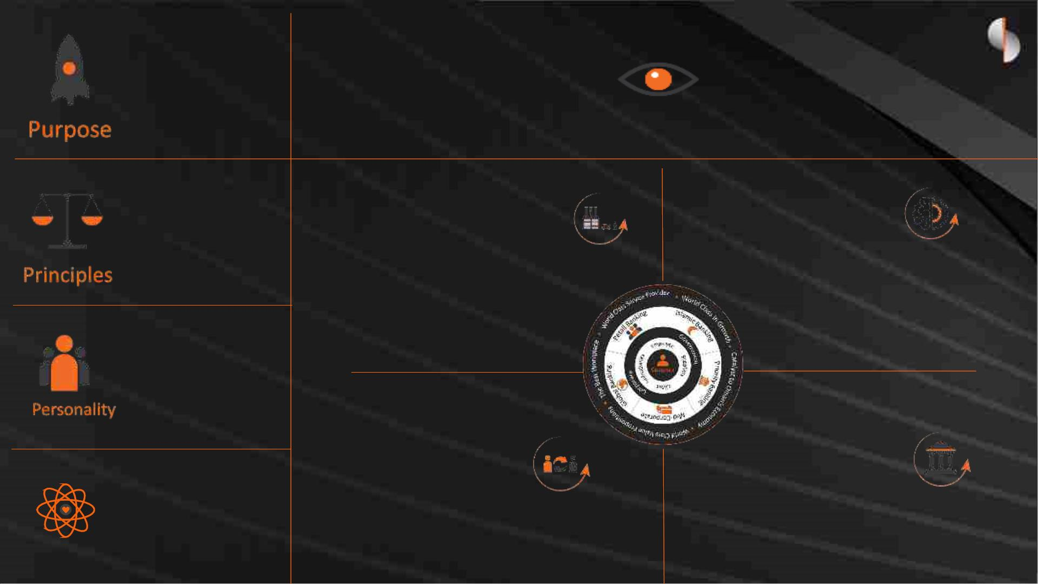
Sohar International
We Help
People
‘WIN’.
To be a World Leading Omani Service Company
that helps customers, communities and people to prosper and grow
Re-Imagine Banking
Business
Re-Evaluate
Value Chains
• More Vision
• More Value
• More
Velocity
•
•
•
Scope – beyond banking
Ecosystem
Business Model
•
BI, Analytics & Product
Development
•
•
Operations Management
Distributions & networks
• Sharp
• Human
• Unstoppable
Re-connect with
Our Customers
Re-build the
Organization
• Be Straight Up
• Be Open Minded
• Do The Right Thing
• Make It Better
•
•
•
Journeys / customer experience
Engaging & communicating
Managing & leveraging relationships
•
•
Structure & Alignment
Capabilities – People, Systems &
Processes
Values
•
Learning & development

Slide 5
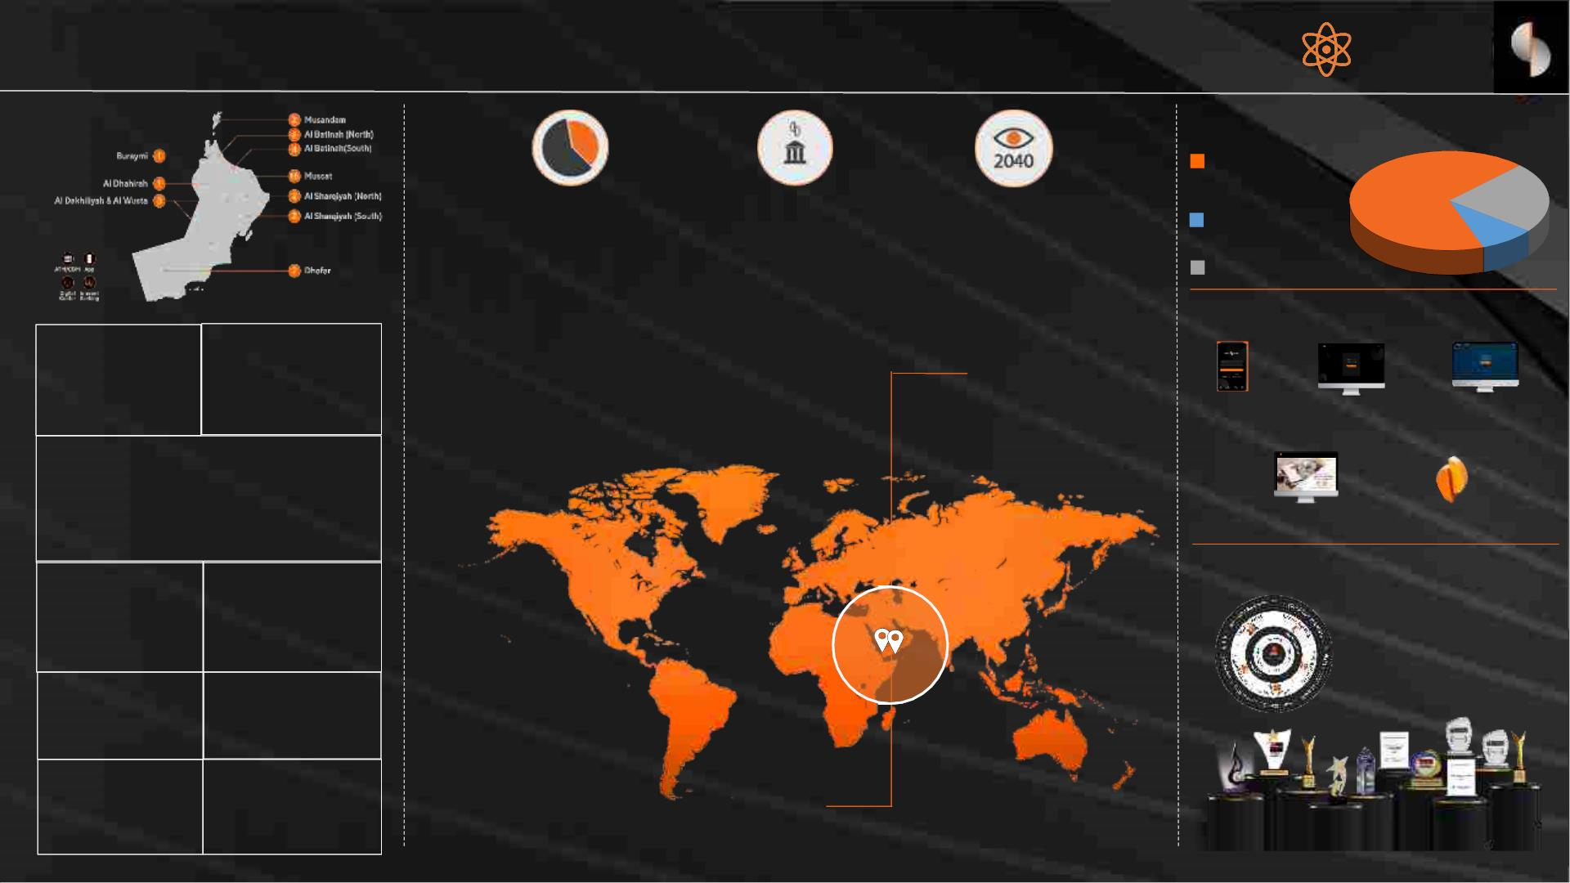
Sohar International
Oman’s
Vision
2040
Strong Brand
Presence &
Loyalty
Extensive
Network
Ownership Structure
Government &
Quasi Govt. 67%
Fastest Growing Bank
in Oman
2nd Largest Bank in
Oman
Oman’s
Vision 2040
Institutions 23%
Other 10%
Listed on Muscat Stock Exchange (MSX) - Market Cap: ~ USD 1.7 bn
Top Ranked Bank in ROE in GCC
Strong domestic presence
a) Organic
Extensive Digital Channels
Branches
ATMs
85 168
b) In-Organic Growth -
M&A
Mobile
Banking
Retail
Corporate
Internet Banking Internet Banking
Customers
520,000 +
Transaction Banking
H2H
Total Assets
Market Share
The winning Formula
6.7B ~ 18
%
Creating an
Ecosystem of
Services
Business Lines
6
Employees
1,582+
Moody’s
Ba1
(Stable)
Fitch
BB
(Stable)
Internationalization of Our Business
a) Kingdom of Saudi Arabia (2023)

Slide 6

Robust Governance Structure &
Risk Management Framework
Board of Directors
Board
Executive, Nomination &
Remuneration Committee
Board
Board
Audit Committee
Credit Approval
Committee
Risk Committee
Key Management Committees
Asset & Liability
Committee (ALCO)
Executive Credit
Committee (ECC)
Management Risk
Committee (MRC)
Investment
Committee

Slide 7
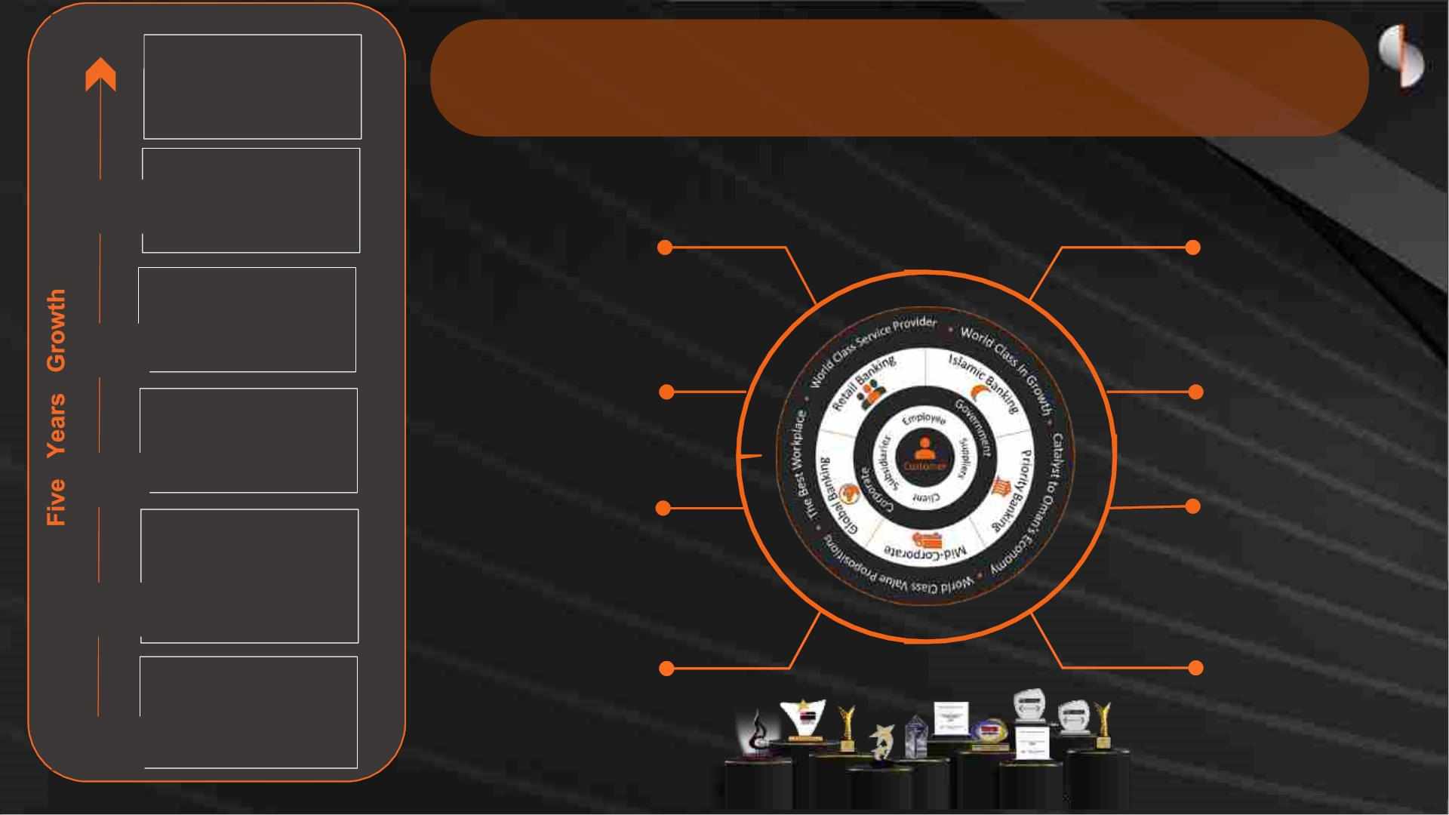
2023
2022
CASA Growth
344%
Sohar International Key Strengths
Customer Deposits
181%
Strong
Well Recapitalized to
Corporate Governance &
Risk Management
Frameworks
support growth
Total Assets
120%
2021
2020
2019
Strong Ownership
Structure, BoD &
Management Team
Strong Liquidity Buffers
and Funding base
Net Loans
74%
Solid Growth and
Resilient Financial
Performance
Strong Brand &
Corporate Franchise
Net Operating
Income
59%
Cutting-Edge Digital
Capabilities & Robust
Technological Platforms
Profit
140%
Robust Growth
Strategy
2018

Slide 8
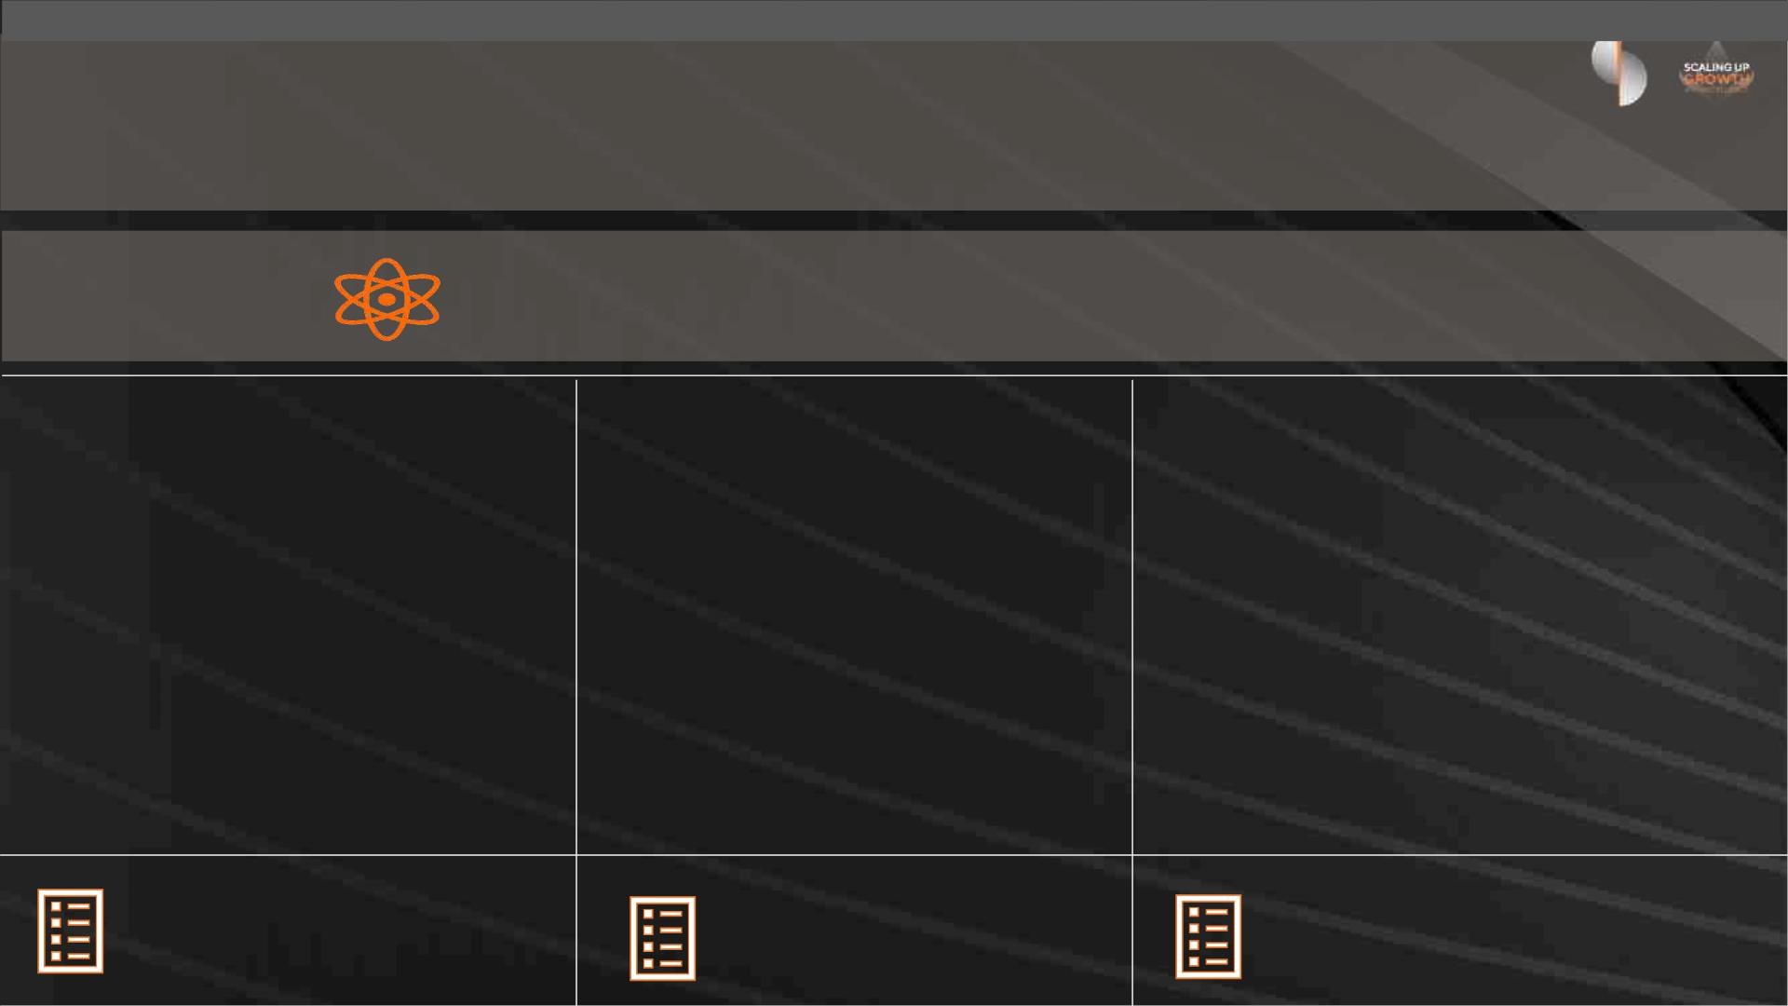
ESG Commitment to enable a positive social, environmental and economic
impact and change, supporting our stakeholders to prosper and grow
Striving to Achieve Excellence In Sustainability
1. Strategic ESG Focus
2. Sustainable Financing
Activities
3. Thought Leadership &
Engagement
• Exclusive Bank sponsor for the Green Hydrogen Summit
Oman 2023
• Conducted ESG benchmarking and
materiality assessment
• Developed final ESG framework
• ESG framework approved by Sohar
International Board 29 October 2023
• Official launch of ESG framework
scheduled for Q1 2024
• Signed mandate with World Bank IFC
for USD200 million of climate-related
financing
• Pipeline of over RO 450 million
sustainable finance opportunities
identified to-date
• Arab Federation of Capital Markets
• Future Sustainability Futures Forum Dubai
•
Solar Week Oman 2023
• 3rd Sustainability Conference Oman
• One of two banks in attendance at Estidamah’s
Sustainable Finance Workshop
• MSX ESG Metrics ESG Data Platform Workshop
Powered by ESG Framework
Powered by ESG Framework
Powered by ESG Framework

Slide 9
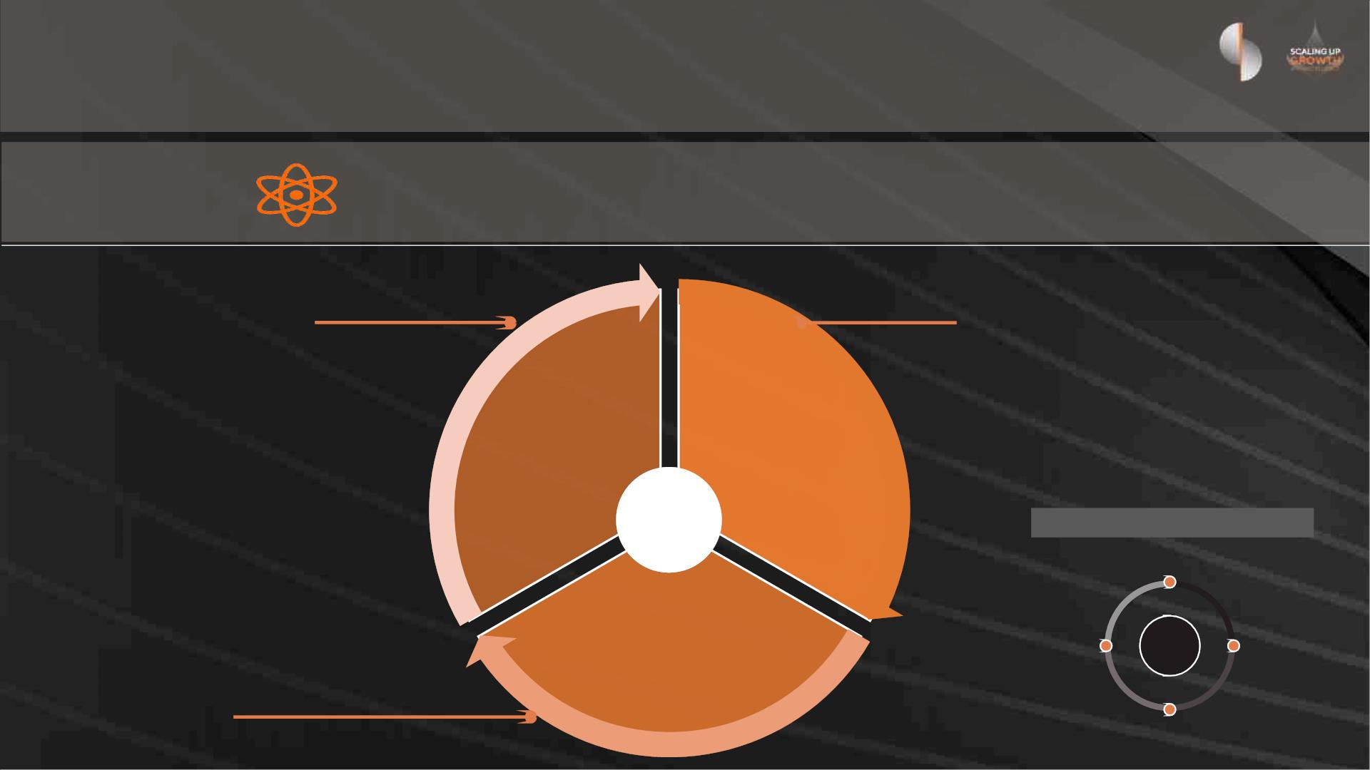
Our ESG Framework
Striving to Achieve Excellence In Sustainability
• Sustainable Finance and Investment
(Decarbonisation; NetZero; Biodiversity and
Natural Capital)
• Governance, Compliance and Ethics (Culture) (AML
and Anti-corruption; Transparency; Financial
performance)
E&S Product / Service Innovation)
• Sustainable Supply Chain / Procurement
• Direct environmental footprint (Energy;
Waste; and Water management)
Enabling the
transition to a
sustainable
future
Embedding
responsible
business
• E and S risk management (ESRM) (including climate
risk)
• Digital Leadership
operations
• Human Capital (Employee Health Safety and
Wellbeing; Diversity and Inclusion; Talent
Attraction; Engagement & Retention; Employee
Training and Development)
Strategy
Underpinned by our values
Be Straight Up
• Customer protection (Privacy and security;
Responsible Communications & Marketing)
Empowering and
developing people –
employees, customers
and communities
• Customer experience
Be Open
Minded
Values
Make it
better
• Financial inclusion, accessibility and education
(financial empowerment)
• Community investment and socio-economic
development [CSR]
Do the Right Thing

Slide 10

Financial
Review

Slide 11
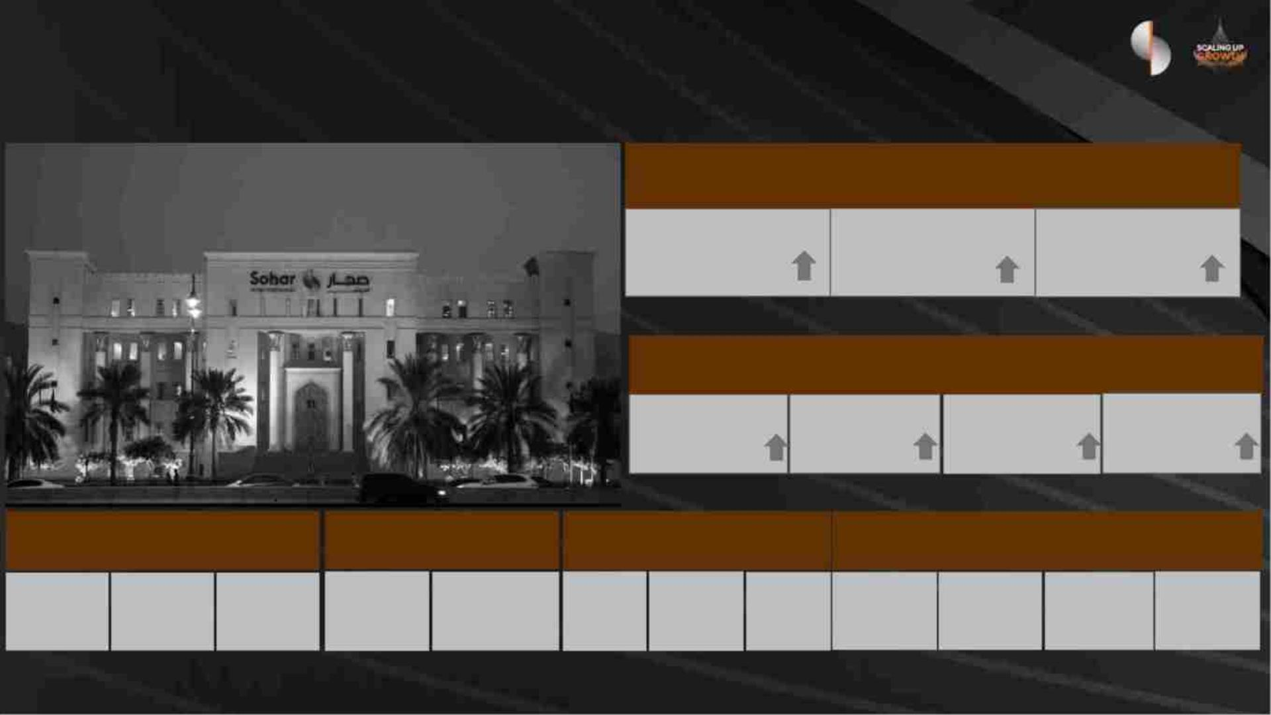
Our Results (as at 31st December 2023)
Earnings (RO M)
Operating Income
163.4 (+23%)
Net Profit
70.3
(+102%)
Operating Profit
86.5
(+11%)
Balance Sheet (RO M)
Total Assets
6,689 (62%)
Total Equity
702 (24%)
Net Loans
3,921
(34%)
Total Deposits
5,103
(99%)
Earnings & Profitability Credit Quality
Capitalization
Funding & Liquidity
NPL Ratio NPL Coverage
Tier 1
14.3% 16.6% 17.9%
LCR
205%
NSFR
137%
CASA %
70%
LTD %
77%
ROE
11.1%
ROA
1.3%
CIR
47.1%
CET 1
CAR
4.8%
143%
Classified as: Internal - Restricted

Slide 12
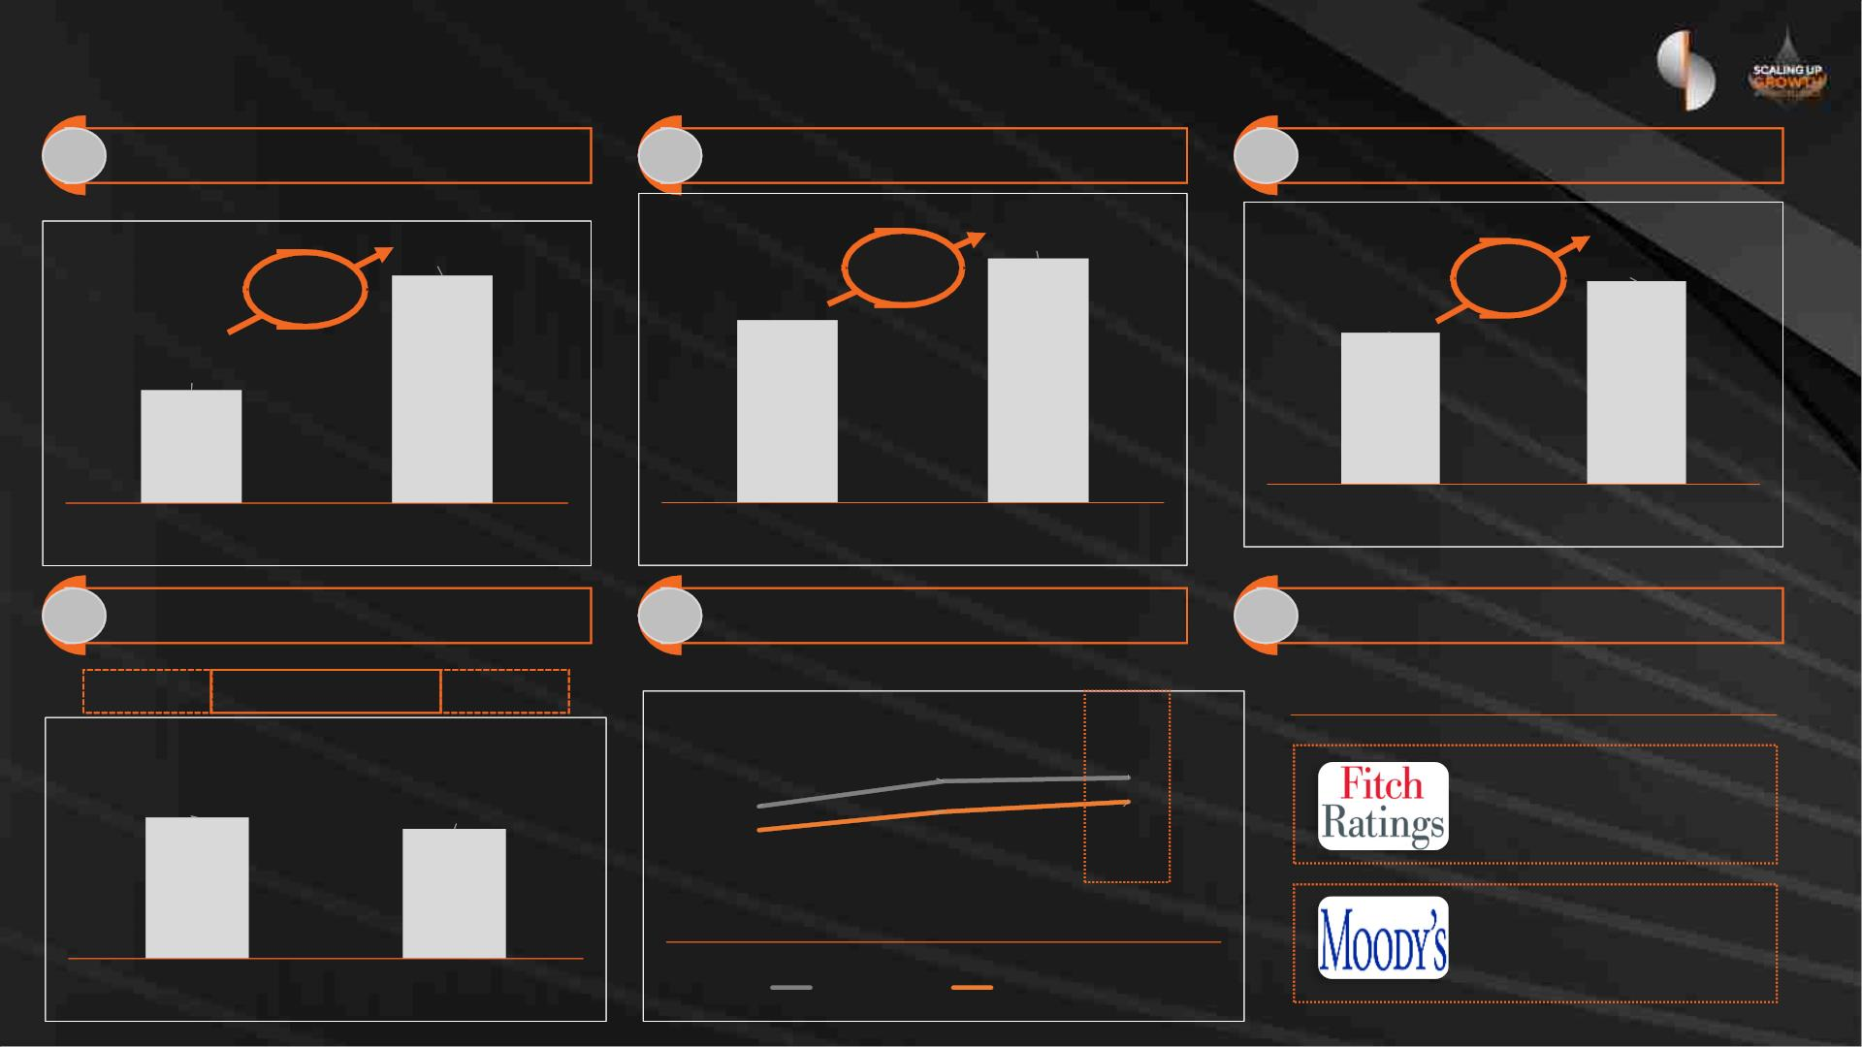
Our Results: Key Highlights (December 2023)
1 Profit for the year
2 Return on Equity*
3 Net Loans and Advances
RO million
11.1%
RO
million
70.3
3,921
2.8%
8.3%
34%
102%
34.9
2,924
12 M 2022
12 M 2023
12 M 2022
12 M 2023
12 M 2022
12 M 2023
4 Asset Quality
5 Capital Ratios
6 Credit Ratings
89%
Coverage Ratio
143%
Credit Rating Outlook
CET1
Tier 1 %
CAR %
21.0%
NPL Ratio %
20.5%
5.2%
4.8%
17.3%
14.3%
BB
Stable
16.6%
17.9%
Ba1
Stable
31-Dec-22
31-Dec-23
31-Dec-22
31-Dec-23
* 2022 adjusted for right issues

Slide 13
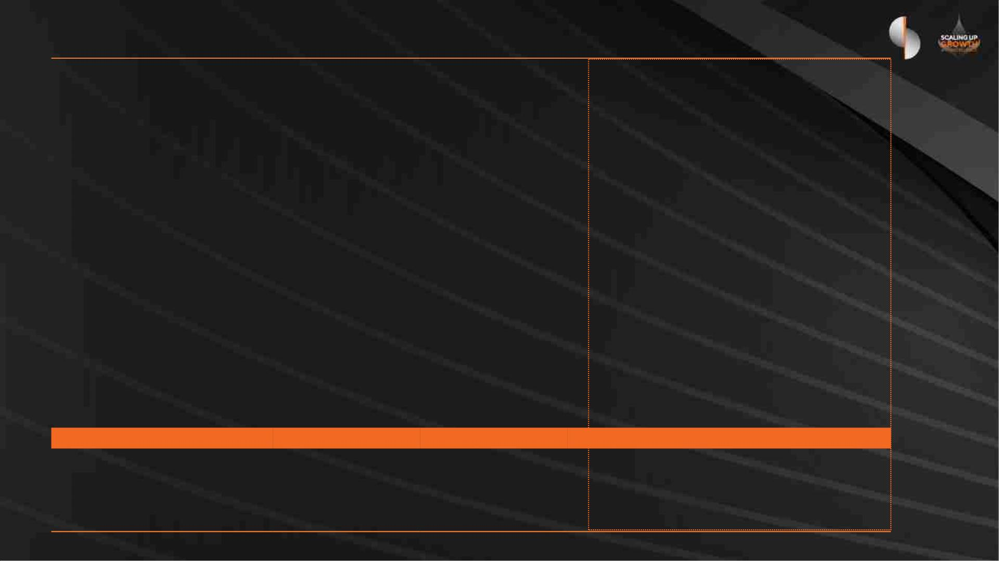
Profit for the 12 months year ended 31 December 2023
RO Million
12 months
2023
12 months
2022
Variance Dec 2023 v Dec 2022
Amount
72.8
%
Interest income
240.1
(121.7)
118.5
167.3
(72.7)
94.6
43.5 %
(67.3) %
25.2 %
Interest expense
Net interest income
(48.9)
23.8
Net income from Islamic financing
and investing activities
7.4
9.1
(1.7)
(18.2) %
Other operating income
37.5
163.4
(76.9)
29.2
132.8
(55.2)
8.4
30.6
28.7 %
23.0 %
Totaloperating income
Total operating expenses
Net operating income before
impairment provisions
(21.8)
(39.4) %
86.5
77.7
8.8
11.3 %
Gain on bargain purchase
91.8
0.0
91.8
n/a
Loan impairment charges and other
credit risk provisions (net)
(105.1)
(39.7)
(65.4)
(164.9) %
Profit before tax
73.2
(2.8)
38.0
(3.1)
34.9
35.1
0.3
92.4 %
9.9 %
Tax expense
Profit for the year
Return on assets (ROA) %
Return on equity (ROE) %*
Cost to income ratio (CIR) %
Cost of risk**
70.3
35.5
101.7 %
0.5 %
1.3%
11.1%
47.1%
2.7%
0.8%
8.3%
41.5%
1.4%
2.8 %
(5.5) %
(1.3) %
* 2022 adjusted for right issues
** Net loans considered in calculation

Slide 14
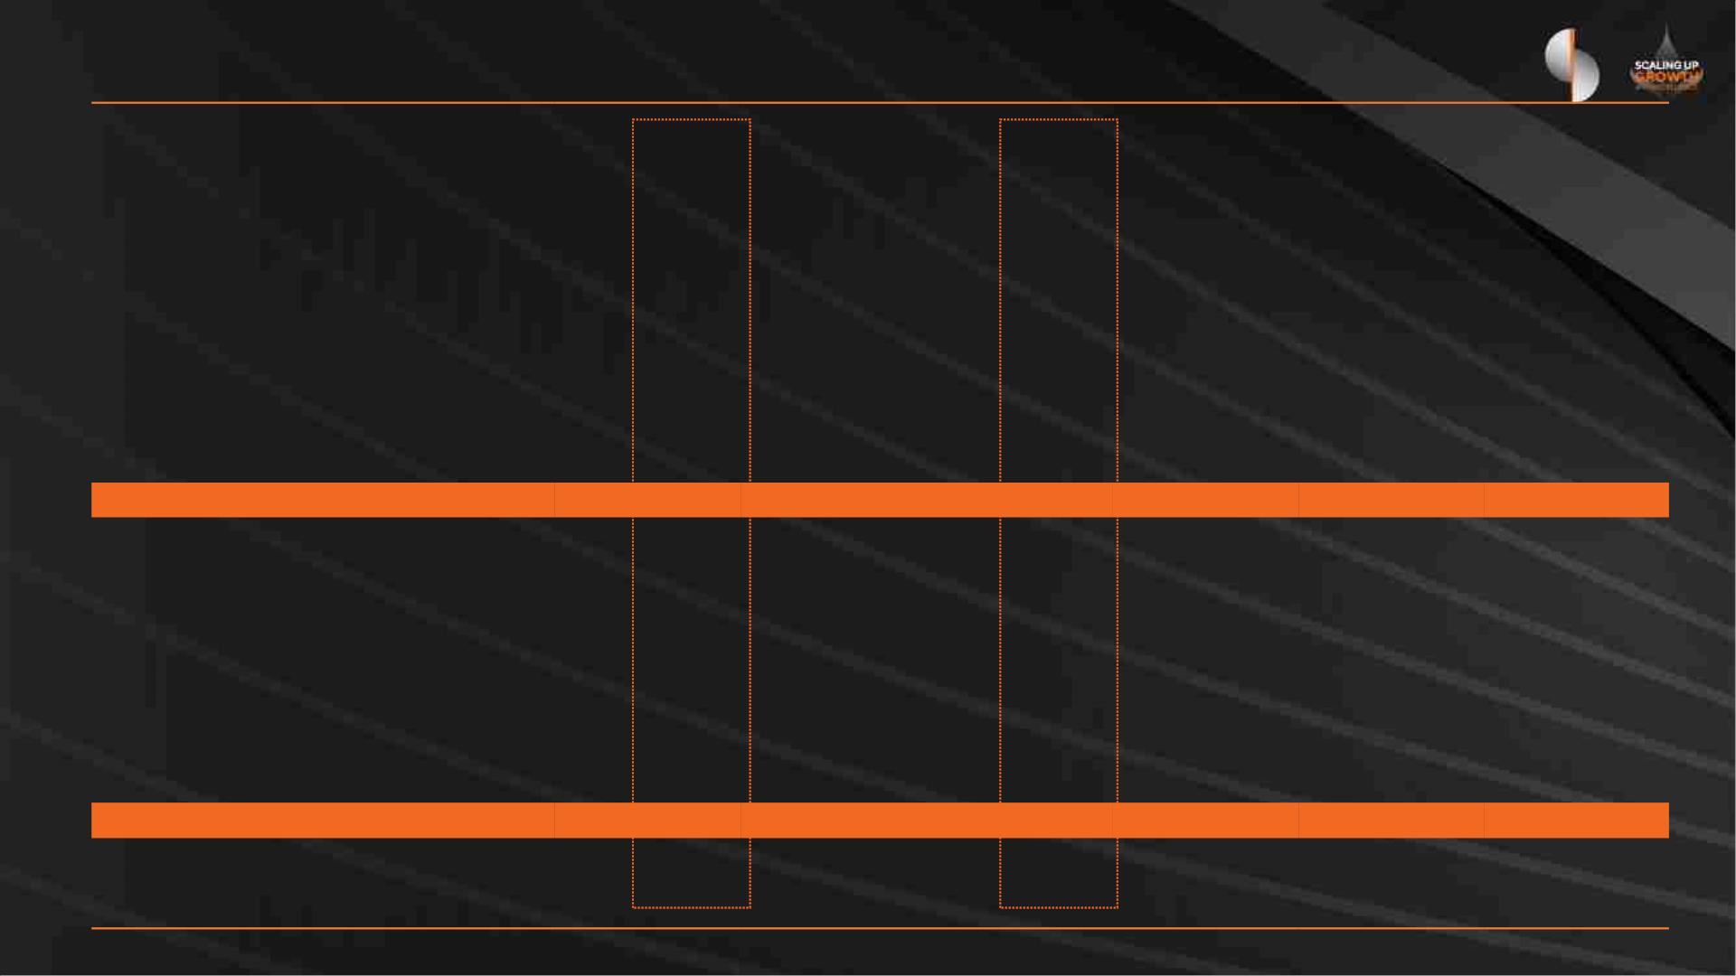
Balance Sheet as at 31 December 2023
Variance
Dec 23 vs Dec 22
RO Million
31-Dec-23
% of Total
31-Dec-22
% of Total
Amount
%
ASSETS
Cash and balances with Central Bank
Due from banks
205.7
652.0
1,711.2
3,921.2
53.6
3.1%
9.7%
125.9
103.9
853.8
2,924.3
66.7
3.0%
2.5%
79.8
548.1
857.3
996.9
(13.1)
-
63.4%
527.3%
100.4%
34.1%
(19.6)%
0.0%
Investment securities
Loans, advances and Islamic financings (net)
Other assets
25.6%
58.6%
0.8%
20.7%
70.8%
1.6%
Investment properties
Property and equipment
2.9
0.0%
2.9
0.1%
75.6
1.1%
53.4
1.3%
22.1
41.4%
Intangible assets
66.6
1.0%
-
0.0%
66.6
100%
TOTAL ASSETS
LIABILITIES
6,688.7
100.0%
4,131.0
100.0%
2,557.7
61.9%
Due to banks
676.1
5,103.0
107.5
10.1%
76.3%
1.6%
806.0
2,560.1
99.4
19.5%
62.0%
2.4%
(129.9)
2,542.9
8.1
(16.1)%
99.3%
8.1%
Customer deposits
Other liabilities
Totalliabilities
5,886.6
88.0%
3,465.5
83.9%
2,421.1
69.9%
Total shareholders’ equity
Perpetual tier 1 capital securities
Total equity
702.1
100.0
802.1
10.5%
1.5%
565.5
100.0
665.5
13.7%
2.4%
136.6
-
24.2%
0.0%
12.0%
100.0%
16.1%
100.0%
136.6
2,557.7
20.5%
61.9%
TOTAL LIABILITIES AND EQUITY
Net loans / deposits
CASA ratio
6,688.7
76.8%
70.0%
4,131.0
114.2%
63.8%

Slide 15
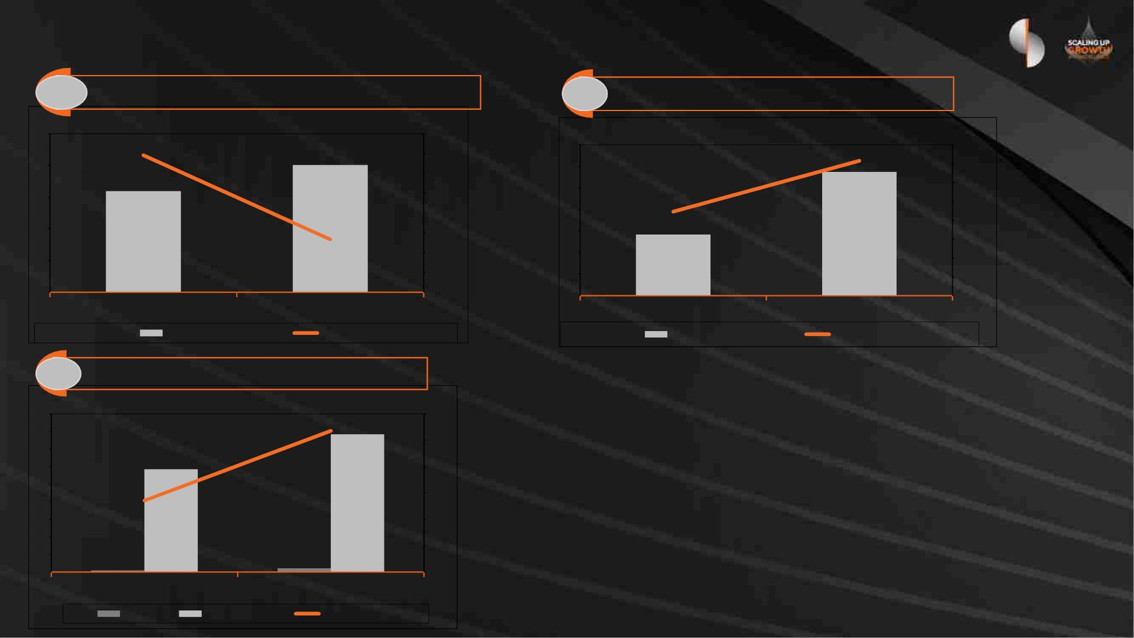
Credit Quality
1 Non Performing Loans (NPL)
2
NPL Coverage
250
200
150
100
50
RO million 5.2%
5.3%
5.2%
5.1%
5.0%
4.9%
4.8%
4.7%
4.6%
4.5%
RO million
143%
287
350
300
250
200
150
100
50
160%
140%
120%
100%
80%
60%
40%
20%
0%
201
89%
142
159
4.8%
0
0
31-Dec-22
31-Dec-23
31-Dec-22
31-Dec-23
Coverage %
NPL
NPL %
Provision
3 Cost of Risk
4,500
4,000
3,500
3,000
2,500
2,000
1,500
1,000
500
RO million
2.7%
3%
3%
2%
2%
1%
1%
0%
1.4%
3,921
2,924
40
105
31-Dec-23
0
31-Dec-22
ECL
Net Loans
Cost of Risk %

Slide 16
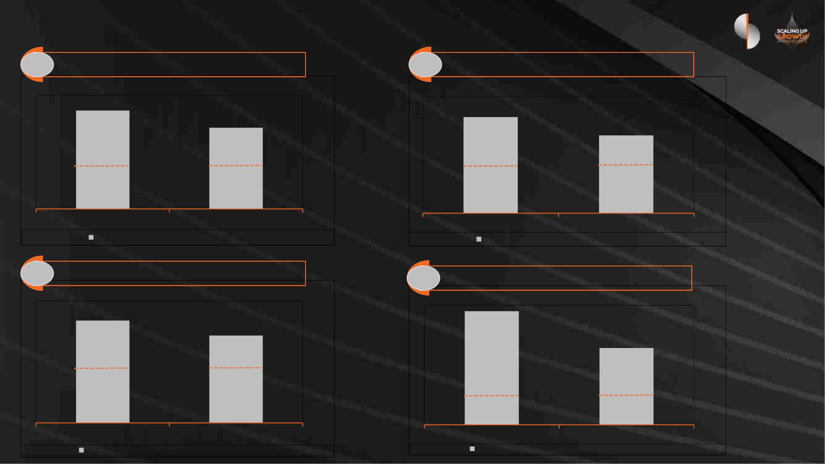
Capital & Leverage
1 CET 1 Ratio
2 Tier 1 Ratio
17.3%
20.5%
14.3%
16.6%
8.25%
8.25%
10.25%
10.25%
31-Dec-22
CET1
31-Dec-23
Minimum Regulatory
31-Dec-22
Tier 1
31-Dec-23
Minimum Regulatory
3 Total Capital Ratio
4 Leverage Ratio ( Local Regulatory basis)
15.2%
21.0%
17.9%
10.3%
12.25%
12.25%
4.50%
4.50%
31-Dec-22
Total Capital
31-Dec-23
Minimum Regulatory
31-Dec-22
Leverage %
31-Dec-23
Minimum Regulatory

Slide 17
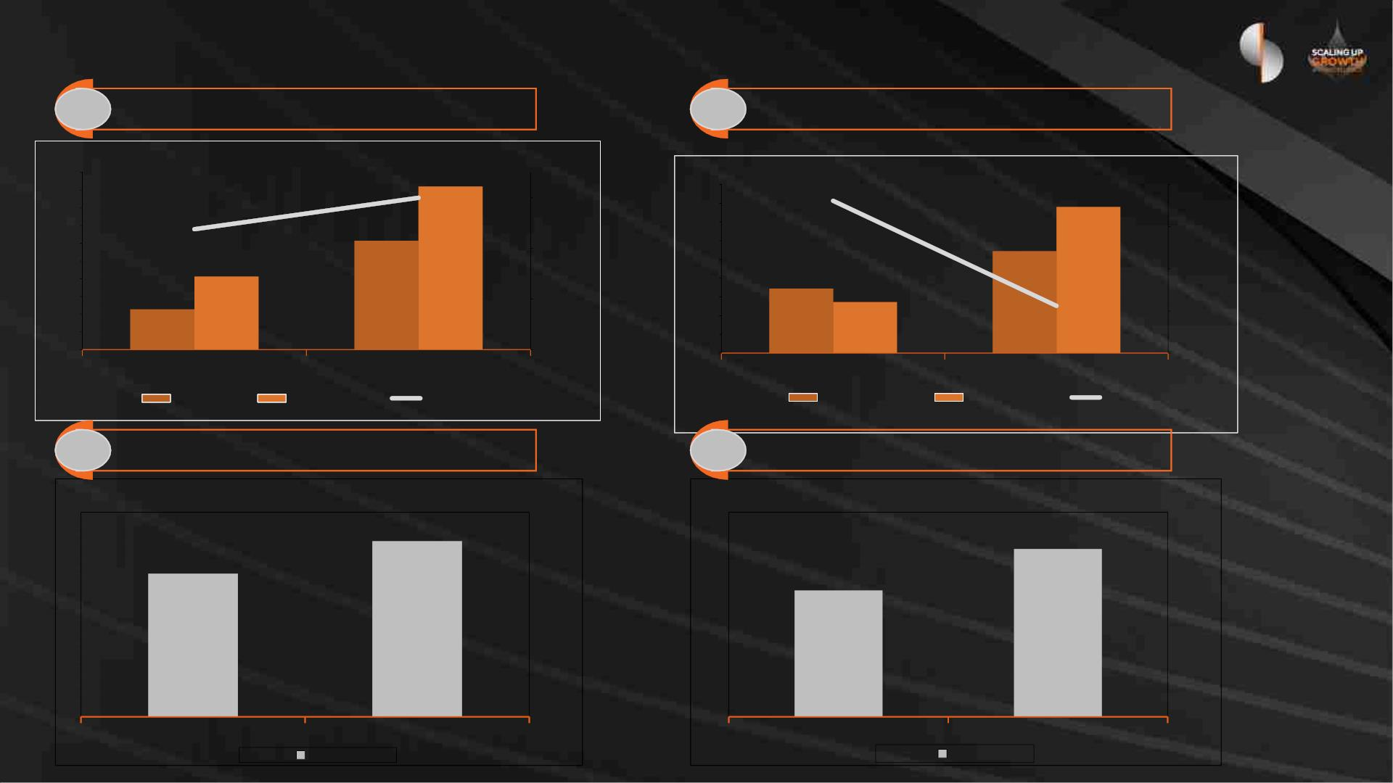
Funding & Liquidity
1 CASA / Customer Deposits %
2 Net Loans to Deposits %
RO billion
5.1
RO billion
5.5
5.0
4.5
4.0
3.5
3.0
2.5
2.0
1.5
114%
5.1
70%
70.0%
60.0%
50.0%
40.0%
5.7
5.2
4.7
4.2
3.7
3.2
2.7
2.2
1.7
120.0%
105.0%
90.0%
75.0%
60.0%
3.6
3.9
64%
2.6
2.9
2.6
1.6
77%
1.0
0.5
1.2
31-Dec-22
31-Dec-23
31-Dec-22
31-Dec-23
CASA
Deposits
CASA %
Net Loans
Deposits
LTD
3 Net Stable Funding Ratio (NSFR)
4 Liquidity Coverage Ratio (LCR)
137%
205%
112%
154%
31-Dec-22
NSFR
31-Dec-23
31-Dec-22
LCR
31-Dec-23

Slide 18

Disclaimer
Important notice
The information, statements and opinions set out in this presentation and accompanying discussion (“this Presentation”) are for informational and reference purposes only and do not
constitute a public offer for the purposes of any applicable law or an offer to sell or solicitation of any offer to purchase any securities or other financial instruments or any advice or
recommendation.
This Presentation, which does not purport to be comprehensive nor render any form of legal, tax, investment, accounting, financial or other advice, has been provided by Sohar
International (“the Bank”) and has not been independently verified by any person. You should consult your own advisers as to legal, tax investment, accounting, financial or other related
matters concerning any investment in any securities. No responsibility, liability or obligation (whether in tort, contract or otherwise) is accepted by the Bank or their officers, employees,
agents or advisers as to or in relation to this Presentation (including the accuracy,completeness or sufficiency thereof) or any other written or oral information made available or any errors
contained therein or omissions therefrom, and any such liability is expressly disclaimed.
Forward looking information
The financial information and other numerical disclosures in this presentation are unaudited. The most recent Annual Report, audited annual financial statements and unaudited quarterly
interim condensed financial statements are available on the Bank’s website.
This Presentation may contain forward-looking statements. Forward-looking statements are statements that are not historical facts; they include statements about our beliefs and
expectations and the assumptions underlying them.
These statements are based on plans, estimates and projections as they are currently available to the management of the Bank. Forward-looking statements therefore speak only as of the
date they are made, and we undertake no obligation to update publicly any of them in light of new information or future events. By their very nature, forward-looking statements involve
risks and uncertainties. A number of important factors could therefore cause actual results to differ materially from those contained in any forward-looking statement. Such factors include
the conditions in the financial markets in the Sultanate, the prevailing market volatility, potential defaults of borrowers or trading counterparties, the implementation of our strategic
initiatives, the reliability of our risk management policies, procedures and other risks.
Non-IFRS measures
This presentation also contains non-IFRS financial detail.

Slide 19

Q & A

